Slide 1

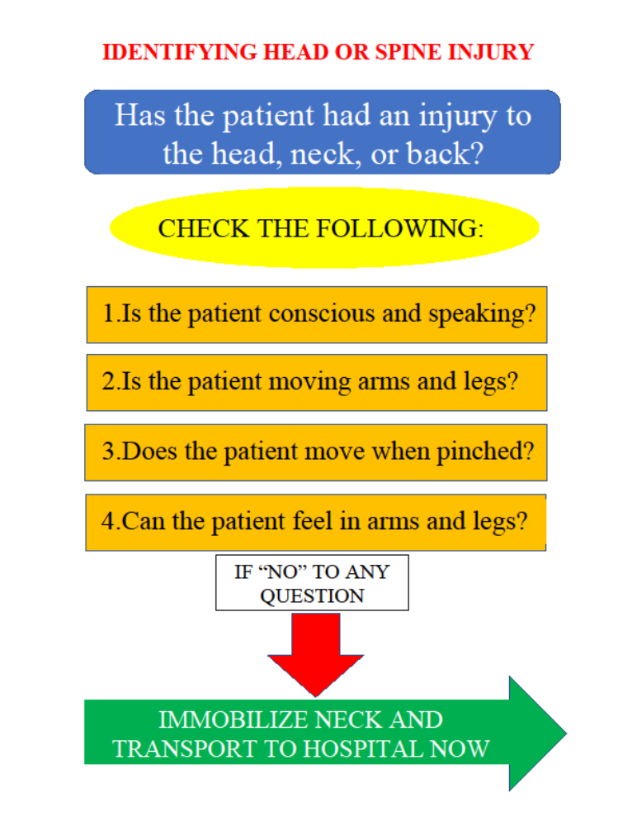
Prehospital care of trauma patients in Tanzania: medical knowledge assessment and proposal for safe transportation of neurotrauma patients
Matthews Lan, MS¹, Noah L. Lessing, BS², Stephen Nyamsaya, BS³, Arnold Matemu, MD⁴, Scott L. Zuckerman^{4,5}, MD, MPH, Hamisi K. Shabani, MD, PhD⁴
Vanderbilt University School of Medicine, Nashville, TN, USA
University of Maryland School of Medicine, Baltimore, MD, USA
Muhimbili University of Health and Allied Sciences, Dar es Salaam, Tanzania
Department of Neurosurgery, Muhimbili Orthopedic Institute, Dar es Salaam, Tanzania
Department of Neurosurgery, Vanderbilt University Medical Center, Hashville, TN, USA
INTRODUCTION
PURPOSE
EDUCATIONAL FLIER
Injuries due to trauma are the leading cause of death worldwide
Every year more than 5 million treatable neurosurgical injuries occur in low- and middle-income countries (LMICs) that do not undergo surgical intervention
Access to neurosurgical expertise is limited in many LMICs, and one important area of need is prehospital care of neurotrauma patients.
Most LMICs lack formal prehospital Emergency Medical Services
Instead, most patients transported by taxi, bus, private cars
There are often delays in presentation to a tertiary center due to:
  long travel times
  financial limitations
  poor infrastructure.
Given that little is known about prehospital care of neurotrauma patients in LMICs, this study sought to assess the knowledge of prehospital transporters in Tanzania and propose an educational intervention to help identify patients with severe neurotrauma.
METHODS
RESULTS
A descriptive, cross-sectional survey was done of individuals involved in prehospital transportation of neurotrauma patients at:
  taxi collection areas at major transit points
  private car stations including motorcycle, taxi, and
  bus stands
  public transport stations
  Emergency Department at Muhimbili National
  Hospital (MNH) and/or Muhimbili Orthopaedic
  Institute (MOI)
Surveys assessed demographic information and medical knowledge with three outcomes:
  Identifying signs of a (1) deceased, (2) sick, or (3)
  clinically deteriorating patient.
Predictors of increased medical knowledge were investigated with univariate and Multivariate Logistic Regression (MLR).
Directed by the survey results, an educational flier was also created to provide information that may help transporters recognize emergency neurotrauma situations
The survey population included 501 participants
    Predominantly young (mean age 36.7 years)
    Predominantly male (84.0%)
More than 70% of participants self-reported being able to recognize a deceased or sick patient
    Yet fewer than 20% correctly listed more than 2
    signs of a deceased, sick, or clinically deteriorating
    patient.
MLR showed that:
    First aid training (Odds Ratio (OR) 2.3, 95%
    Confidence Interval (CI) 1.3,3.9,p=0.002) was a
    predictor of identifying a deceased patient
    Being employed (OR 0.5, 95%CI 0.3,0.9,p=0.021)
    was a negative predictor of identifying a sick patient
    Higher education level (OR 2.3, 95%CI
    1.1,4.8,p=0.032) was a predictor of identifying a
    clinically deteriorating patient
Opinions about ways to improve transport
    Ambulance, helicopter, or rapid transport system
    (33%)
    Increased education (26%)
    Special identifying signs on transport vehicles (14%)
    Improving traffic for prehospital transporters (14%)
Figure 2. Flier about prehospital identification of severe neurotrauma. Also produced in Swahili.
CONCLUSION
In a survey of prehospital transporters of neurotrauma patients in Tanzania, higher education level and first aid training were associated with higher medical knowledge scores.
An educational flier was created to help prehospital transporters identify critically ill neurotrauma patients.
Additional education of prehospital transporters in Tanzania may improve morbidity and mortality of neurotrauma patients.
REFERENCES
1.Injury and violence: the facts 2014.: World Health Organization 2014.
2.Dewan MC, Rattani A, Fieggen G, Arraez MA, Servadei F, Boop FA, et al. Global neurosurgery: the current capacity and deficit in the provision of essential neurosurgical care. Executive Summary of the Global Neurosurgery Initiative at the Program in Global Surgery and Social Change. J Neurosurg. 2018:1-10.
3.Leidinger A, Kim EE, Navarro-Ramirez R, Rutabasibwa N, Msuya SR, Askin G, et al. Spinal trauma in Tanzania: current management and outcomes. J Neurosurg Spine. 2019:1-9.
4.Moshi H, Sundelin G, Sahlen K-G, Sörlin A. Traumatic spinal cord injury in the north-east Tanzania - describing incidence, etiology and clinical outcomes retrospectively. Glob Health Action. 2017;10(1):1355604-.
5.Rashid SM, Jusabani MA, Mandari FN, Dekker MCJ. The characteristics of traumatic spinal cord injuries at a referral hospital in Northern Tanzania. Spinal Cord Ser Cases. 2017;3:17021.
6.Kuzma K, Lim AG, Kepha B, Nalitolela NE, Reynolds TA. The Tanzanian trauma patients' prehospital experience: a qualitative interview-based study. BMJ Open. 2015;5(4):e006921.
7.Malomo TA, Oyemolade TA, Adeleye AO. Determinants of Timing of Presentation of Neurotrauma Patients to a Neurosurgical Center in a Developing Country. J Neurosci Rural Pract. 2018;9(4):545-50.
8.Ram K, VaraPrasad K, Krishna MK, Kannan N, Sundar V, Joseph M, et al. Prehospital Factors Associated with Discharge Outcomes: Baseline Data from the Andhra Pradesh Traumatic Brain Injury Project. World Neurosurg X. 2019;2:100020.
9.Cnossen MC, van der Brande R, Lingsma HF, Polinder S, Lecky F, Maas AIR. Prehospital Trauma Care among 68 European Neurotrauma Centers: Results of the CENTER-TBI Provider Profiling Questionnaires. J Neurotrauma. 2018.
10.Faul M, Xu L, Wald M, Coronado V. Traumatic Brain Injury in the United States: Emergency Department Visits, Hospitalizations and Deaths 2002-2006. . Altanta (GA): Centers for Disease Control and Prevention, National Center for Injury Prevention and Control; 2010.
11.van Adrichem DC, Ratering MRHA, Rashid SM, Jusabani MA, Poppe VE, Mwaitele HA, et al. Penetrating spinal cord injury causing paraplegia in a bird hunter in rural Tanzania. Spinal Cord Series and Cases. 2019;5(1):49.

