Slide 1


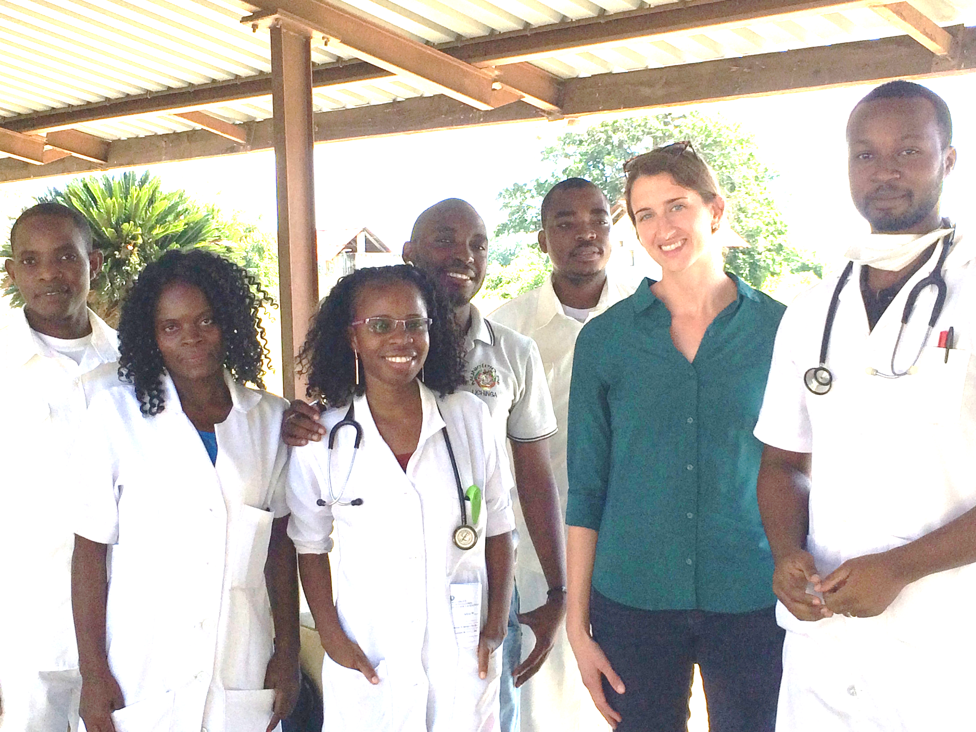
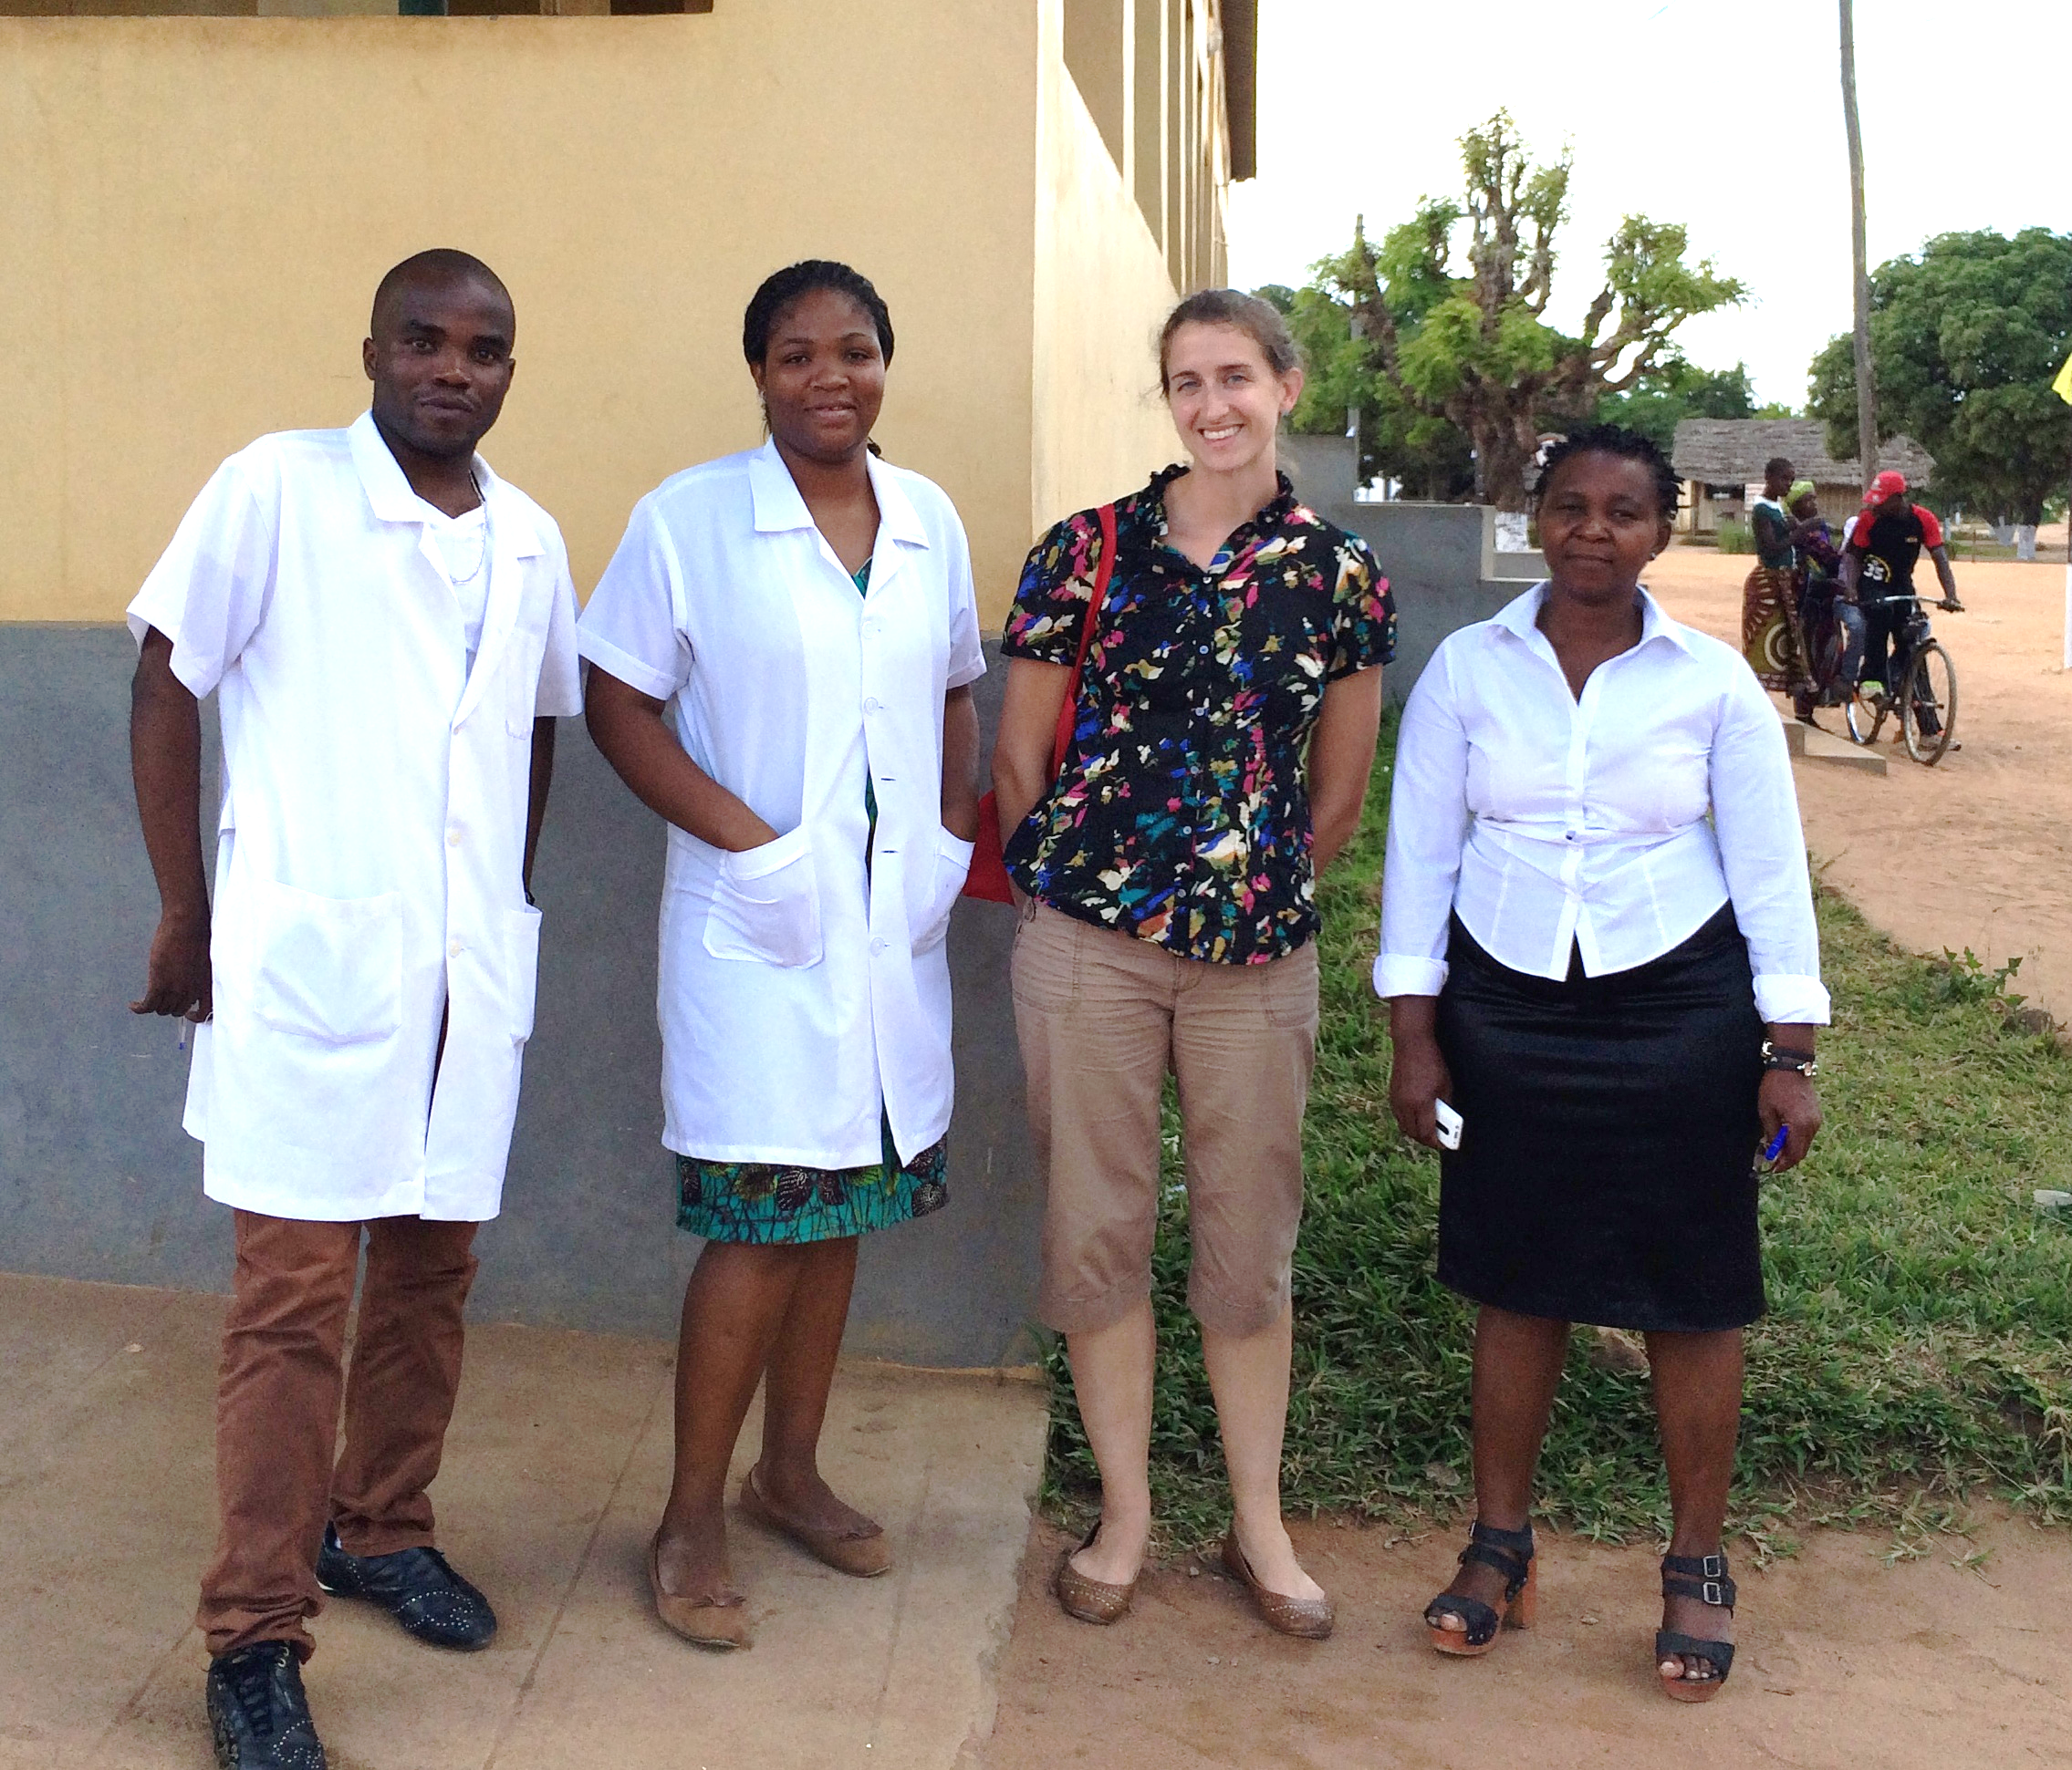
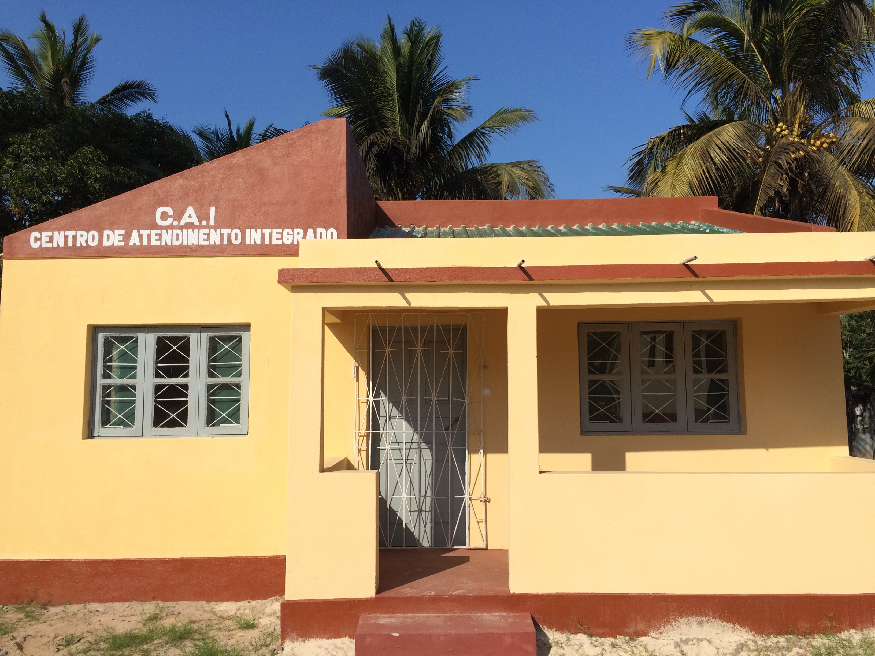
Assessing the quality and impact of clinical services for gender based violence in rural Zambézia, Mozambique: Summary of initial observational assessments
Erin R. Graves, BSN, MPH¹; Carolyn M. Audet, PhD, MSc.^{1,2}; Yazalde M. Chire, MBA^{3*}
Vanderbilt University Medical Center, Vanderbilt Institute for Global Health¹; Department of Health Policy², Nashville, TN; Friends in Global Health³, Quelimane, Mozambique
*at the time of practicum research
† RU/VH: Research Universities (very high research activity); RU/H: Research Universities (high research activity); DRU: Doctoral/Research Universities; Spec/Medical: Medical schools and medical centers; Spec/Health: Other health profession schools.
Trainee research topics were 68% in infectious (47% HIV/AIDS), 18% in non-communicable, and 15% in infection-related non-communicable diseases (“combined”). Non-communicable and combined disease topics increased from 17% in 2004-2007 to 40% in 2008-2011. At least 10% of projects focused on each of these: basic science, health behavior, health care systems, pulmonary diseases, parasitology, sexually transmitted infections, tuberculosis, maternal and/or child health, and cancer. Of 1,617 papers in PubMed, FICRS-F alumni were first author of 501 (31%). The median (IQR) journal impact factor was 3.4 (2.2-4.7), and publications were cited 8 (3-19) times, even though many were published so recently that there have been few citation opportunities to date. Alumni who were postdoctoral Fellows (p<0.001), from LMICs (p<0.001), were supported in earlier Program years (p=0.003), and had longer duration (>1 year) of support (p=0.04) had higher publication outputs, compared to doctoral Scholars, Americans, later Program trainees, and those in the Program for only one year. Other demographic factors (e.g., sex) and research topics (e.g., infectious vs. non-communicable diseases) had little association with publication output except for trainees with research topics involving children, who had on average fewer publications (p=0.004).
Description of Findings and Suggestions Based on Initial GBV Site Observations
Project Purpose
The Mozambican Ministry of Health (MoH), with support from the Centers for Disease Control and Prevention (CDC) Mozambique and other partners, began an initiative to standardize and scale up a national program to improve gender based violence (GBV) care, not only to mitigate GBV occurrence, but also to minimize risk for HIV infection.
Questions remain about optimal strategies for increasing GBV service demand and survivors’ completion of post-exposure prophylaxis (PEP) to prevent possible HIV transmission. In May 2015, CDC Mozambique requested Friends in Global Health (FGH) to conduct an evaluation of the GBV and PEP services in all Zambézian districts where FGH provided technical assistance.
To create a baseline understanding of the status of GBV response and services in these sites, FGH formed a team to conduct baseline observational assessment visits at health facilities (HF) in each of district “headquarters,” focusing on the following:
Site | Strengths Observed | Challenges Observed | Suggestions for Future
Alto Molocue | Good support from FGH Technical Advisor Have a District GBV Committee and the various sectors share monthly GBV reports | No private space for integrated service Only one GBV entry point (Maternity) Not using GBV Notification Form consistently or for observations, “space is too insufficient for notes/comments” Discrepancy in use of PEP documentation form Not consistent as a “One-Stop Model” (police don’t come) No system for community follow-up if patient doesn’t return | All sectors need to review (or have re-training regarding) GBV flow and use of GBV documents Need other entry point and/or identify new private space for PU Regular GBV Committee meetings
Chinde | Have a District GBV Committee PEP Kit is present and complete in all entry points in hospital | Lack of use of GBV Notification Form Lack of written GBV flowchart Lack of list of key GBV persons Not able to consistently function as PU, police don’t come GBV Focal Point not able to supervise over attending doctors No system for community follow-up if patient doesn’t return | GBV Committee needs to create an operational integrated services flowchart for GBV cases Need to create contact list of all members and key contact persons Initiate GBV Committee meetings
Gilé | In the process of creating a District GBV Committee New psychologist joining Observed proper completion of GBV Notification Form for one physical violence case | No private space for integrated service Only one GBV entry point (Maternity) Difficulties with getting police point persons to come to US (not consistently operating as “One-Stop Model”/PU) New Focal Point doesn’t have much experience with GBV No system for community follow-up if patient doesn’t return | Ideal to create a second GBV entry point and/or identify new private space for “One Stop Model” More training is needed re: GBV response and patient flow/A.I. Initiate GBV Committee meetings
Inhassunge | District GBV Committee having monthly meetings Private GBV room PEP Kits & forms in each entry Lawyer very engaged Leaders referring GBV cases Improvements since March | Don’t have enough GBV materials to give out to community Documentation and reporting of GBV cases not consistent Police contact person who received GBV training has since left, new contact isn’t engaged or participatory (not arriving to US if case and not attending Committee meetings) No system for follow-up in community if patient doesn’t return | Would like more brochures and materials to be able to give to communities All sectors, especially police, need to review (or re-training) for AI services Encourage all partners to participate in all Committee meetings
Ile | Have started to receive GBV cases coming from home (messages are getting to communities!) Have a District GBV Committee | Flow for integrated services still rather weak/inconsistent, especially for cases of physical or psychological violence Not operating as “One-Stop Model” (police don’t come) GBV data collection plan not clear Lack of template or instructions for reporting GBV data No system for community follow-up if patient doesn’t return | All sectors need to review (or have re-training regarding) GBV flow and use of GBV documents Need to identify new private space for One-Stop Model Regular GBV Committee meetings
Maganja da Costa | Motivated GBV team Identified a new private space for “One-Stop Model” Have two psychologists Each hospital entry point has PEP Kit District GBV Committee that meets regularly and working to resolve issues | Not using GBV Notification Form for observations or follow-up notes as indicated Frequent staff rotation -> difficult to train all new personnel Lack GBV documentation supervision GBV data collection plan not clear Team reports difficulty responding to cases due to other facility requirements No private space for integrated service No system for community follow-up if patient doesn’t return | All sectors need to review (or have re-training regarding) GBV flow and use of GBV documents Continue with plans to create a new “One-Stop Model” office Assign proper supervision of GBV documentation
Mopeia | Identified private space for GBV care (needs renovation) District GBV Committee has met at least once Detailed Committee members contact list Detailed PEP & GBV flowcharts | Hospital entry point for GBV cases is Maternity, but only PEP Kit is in elsewhere in emergency room (gap in workflow) Inconsistent use of GBV Notification From and GBV response flow (not using at all for physical or psychological GBV cases) Not operating as “One-Stop Model” (police don’t come to clinic) GBV team members weren’t well-informed about community education efforts (couldn’t give specific info) No system for community follow-up if patient doesn’t return | Continue with plans to create a new “One-Stop Model” office (need to request for financial assistance) All sectors need to review (or have re-training regarding) GBV flow and use of GBV documents Regular District GBV Committee meetings
Morrumbala | Health staff in Maternity and FP are doing GBV screening Pharmacy is open 24h Have 2 psychologists available for patients Have identified a private space for GBV care (need to renovate) | No private space for integrated service Only one GBV entry point (Maternity) PEP not with Kit, only give at pharmacy Not operating as PU, police don’t come Inconsistent use of GBV Notification From and GBV response flow (not using for cases other than rape, missing GBV cases) Focal Point collects data on computer, not on forms No system for community follow-up if patient doesn’t return No functioning District GBV Committee | All sectors need to review (or have re-training regarding) GBV flow and use of GBV documents Continue with plans to create a new “One-Stop Model” office (need to make formal request for financial assistance) Develop a District GBV Committee & meet regularly w/ other sectors
Namacurra | Functioning “One-Stop Model” space (partners from other sectors come to clinic) District GBV Committee has had some meetings Have a system/plan in place for follow-up in community if patient not returning | Not using GBV Notification Form for observations/comments or follow-up notes, “space is too insufficient for notes/comments” (per GBV team members) Lack GBV brochures and materials to be able to give out to community members and/or interested patients | Regular GBV Committee meetings Need GBV materials to be able to give out and educate patients better Use GBV team members from this site to help provide support to not only peripheral sites in district, but other districts struggling to ensure quality, integrated GBV services
Pebane | District GBV Committee has regular contact together Motivated GBV team CAI is built, team eager to use Same GBV team members respond to cases reported at 7º de Abril clinic & hospital | Inconsistent use of GBV Notification From (not using for cases other than rape, thus missing forms for some recent GBV cases) All forms and GBV documentation is currently arquived in one binder at the hospital site (could result in lost forms) CAI still requires some final construction, but awaiting “materials and equipment,” unsure opening date No system for follow-up in community if patient doesn’t return | Team needs training re: GBV forms Need to work with CAI partners to encourage completion of building so space can be utilized as intended GBV team eager to include community leaders in trainings Initiate GBV Committee meetings
With Namacurra and Macuse clinical sites’ GBV response team members on a baseline assessment site visit June 1, 2015.
Results
Detailed reports for each site visit, as well as a program-wide summary report were completed and disseminated FGH leadership, members the GBV Evaluation team, and district-level MoH teams. The final summary report was also presented to CDC-Mozambique.
Overview of Findings:
Almost universally across districts, very few GBV cases are self-reporting and/or are referred to HF for care/services;
Inconsistent use of the GBV tracking tools in a majority of sites;
Many sites reported having difficulty with GBV data collection and reporting related to lack of an instrument, template, or consistent instructions;
Very few sites operating with a true “One-Stop Model” at this time (in most areas, victim still has to go to the police station, law office & social action office to seek their services);
Majority of GBV survivors (regardless of PEP receipt) are not returning for follow-up clinical or psychosocial care;
Almost all sites lack a system, plan, or available personnel to conduct community follow-up for GBV survivors not returning;
Not all GBV Focal Point persons are available to have as active a role as they should (most have many other roles at HF; aren’t necessarily able to focus on patient follow-up, may not have time to explain all references to family, etc.);
In several sites, GBV response team is only being called if case is sexual assault (not for physical or psychological violence);
Some sites seems to have weak communication to GBV survivor or their families to explain referrals;
None of the sites utilize age-appropriate materials in providing post-GBV care to child victims (e.g. dolls, colored pencils, etc.);
Lack of resources or efforts to provide rehabilitation not only to the GBV survivor, but also to the abuser (to break the cycle of violence and reduce GBV occurrence).
Key Areas of Observation and Inquiry for Baseline Assessment
Overview | Specific Inquiries
Patient registry, completion of forms, and data collection | Correct forms present? Completing forms correctly? Documentation of follow-up, especially after PEP? Data collected correctly? Reporting?
Human resources and responsible personnel | What clinicians and other personnel are available? Training for personnel treating GBV patients? Training for personnel completing forms?
Quality of care for victim | Using proper integrated services flow? Referrals received and made properly? Necessary clinical and technical materials available? Type of infrastructure utilized in patient response? Privacy and patient well-being attended to?
Response from partnering sectors | Present in community? Active in GBV response? Engagement with community leaders and associations to disseminate information?
Additional attention point | What does the community know about PEP and other services for victims of GBV? What do the community leaders, community activists, and residents know?
Conclusions
Guided in part by information gained in the baseline site assessments, our team developed a GBV-Initiative evaluation plan and protocol. The three-pronged approach will take place over an 18-month evaluative period in which interventions will focus on increasing demand for GBV services, building capacity for GBV service providers, improving GBV data documentation, and assessing PEP use and completion. The evaluation aims to assess the delivery of GBV clinical services, the use of and adherence to PEP following a GBV-related exposure, and the impact of enhanced training, tools, and access to follow-up care at every FGH-supported district site. The VUMC/FGH team received protocol approval from CDC Mozambique, local ethics committees, and VUMC IRB to initiate the GBV Evaluation-related interventions and research.
Methods
Referencing training resources produced by FGH, Mozambique MoH, CDC, and other agencies implementing GBV services, with adaptations based on FGH program needs, our team developed a GBV Site Visit Assessment Tool focusing on the (above) priority areas of GBV care. Using the new tool, our team made visits in June and July 2015 to twelve of the FGH-supported district headquarters HF to conduct baseline assessments to better understand the current status of GBV clinical response and service utilization in these communities. At each site, our team explained the evaluation to district health officials and FGH leadership, met with members of the clinics’ GBV response teams, and conducted detailed assessments through informal interviews and observational surveys.
Visit to the GBV Integrated Services Center (C.A.I.) in Pebane district headquarters on June 30, 2015 during baseline assessment site visit. The C.A.I. aims to provide a “One-Stop Model” for comprehensive GBV care and services, including medical, psychological, legal, and social welfare. This C.A.I. is one of the only sites of its kind in Zambézia Province.
With members of the GBV response team at Maganja da Costa headquarters hospital site on a baseline assessment site visit June 3, 2015.
Acknowledgements
Thank you for the support of the entire Vanderbilt Institute for Global Health (VIGH), which made this practicum possible through the VIGH General Scholarship, the Overall Fellowship, and the MPH Practicum Award. Specific thanks to Dr. Carolyn Audet, Dr. Bill Wester, Dr. Troy Moon, Dr. Sten Vermund, Dr. Doug Heimburger, Dr. Marie Martin, Julie Lankford, and Ann Green from VIGH. Sincerest thanks to the entire staff of Friends in Global Health (FGH), especially Yazalde Chire, Dr. Sara Van Rompaey, Dr. Magdalena Bravo, Dr. Monica Negrete, Dr. Themos Ntasis, Dr. Lázaro Calvo, Jaime Mucanhenga, Francisca Bacião, and Marcia Souza. Thank you to the MPH Program staff, including Annie Smart, Will Bruer, Rebecca Mohr, and Amy Richardson.

