Slide 1

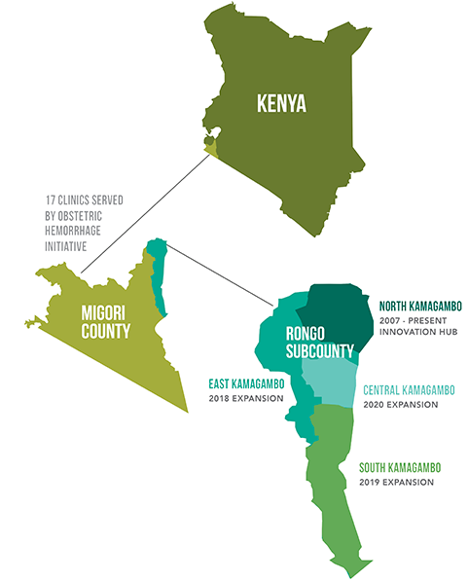
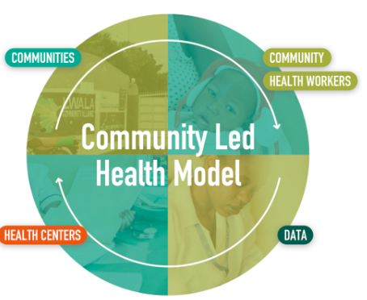
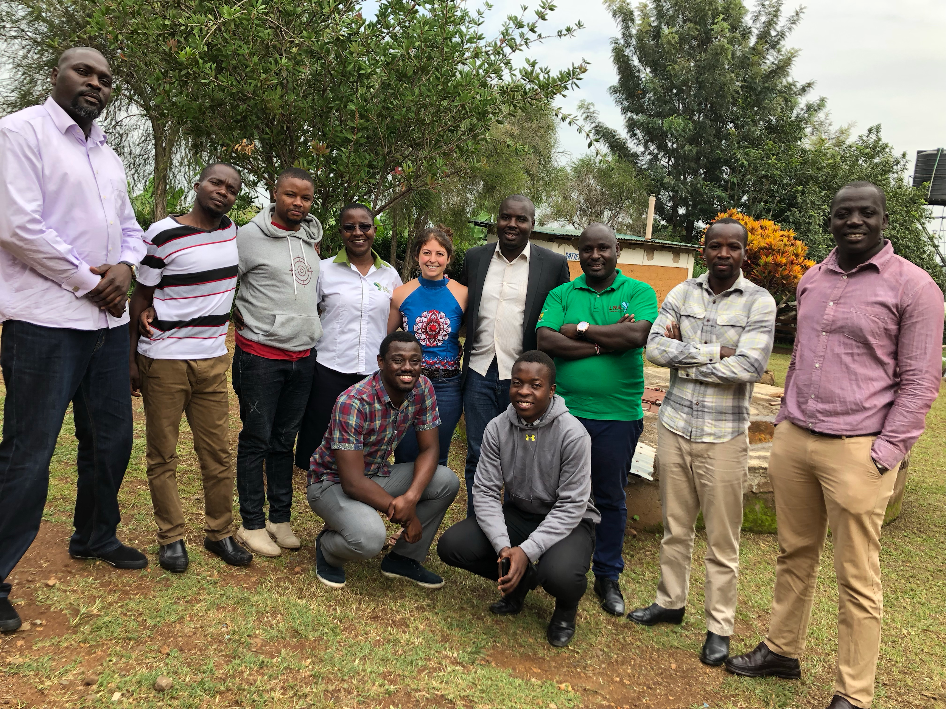
Monitoring and Evaluation Programs
at Lwala Community Alliance
Emily Sedillo, MPH candidate • Danielle Ressler, Impact Director • Ash Rogers, Executive Director
Background
Outcomes
Discussion
Lwala Community Alliance (LCA) is a data-driven non-profit organization with a mission to build the capacity of rural communities in Western Kenya to advance their own comprehensive wellbeing.
The continual, diligent monitoring and evaluation of LCA’s program interventions is essential in order to fulfill its mission.
Completed Documents
CHW study protocol
Monitoring and Evaluation plan standardization protocol
Annual Nutrition Household Survey
Additional Contribution
Served as focus group enumerator
Contributed to a committee researching innovative programing technologies
CHW trainings
Nutritional information groups for breastfeeding mothers
MCH outreaches
After school health clubs/uniform fittings
Through working on a variety of projects, I was able to engage in each portion of LCA’s “Community Led Health Model” and develop invaluable skills in collaboration and program evaluation to assist in advancing the mission of LCA.
Objectives
Investigate the quality and content of training Lwala Community Health Workers (CHW) receive and how that translates into maternal/child health (MCH) outcomes via data collection
Improve skill in monitoring and evaluation processes to inform future programming
Gain practice in communication and collaboration on an interprofessional team of doctors, researchers, and the community to provide effective, sustainable care
Acknowledgements
I would like to express my sincere gratitude to Ash Rogers who connected me to LCA, Daniele Ressler who served as my supervisor during my time in Kenya, and Brad Hawkins for his support in the structuring of the practicum. I would also like to thank the members of the LCA team in Kenya for their hospitality, friendship, and lessons learned.

