Slide 1
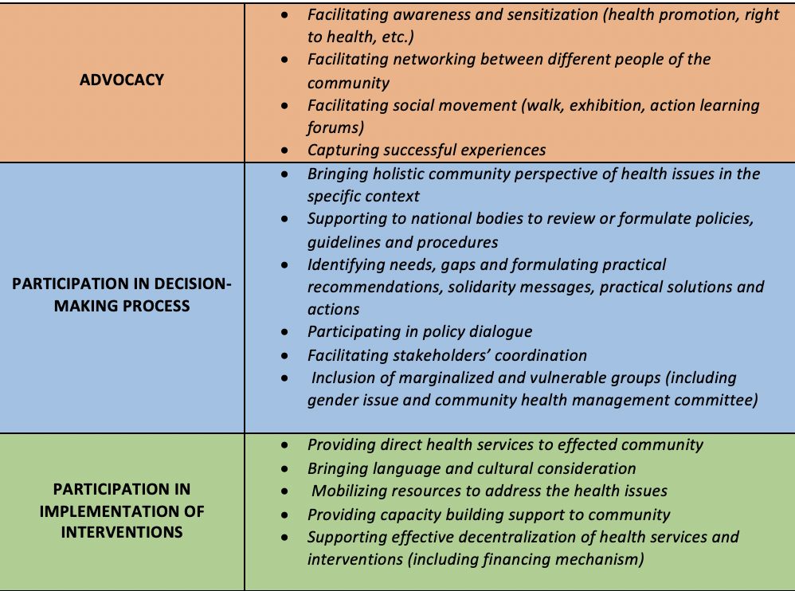
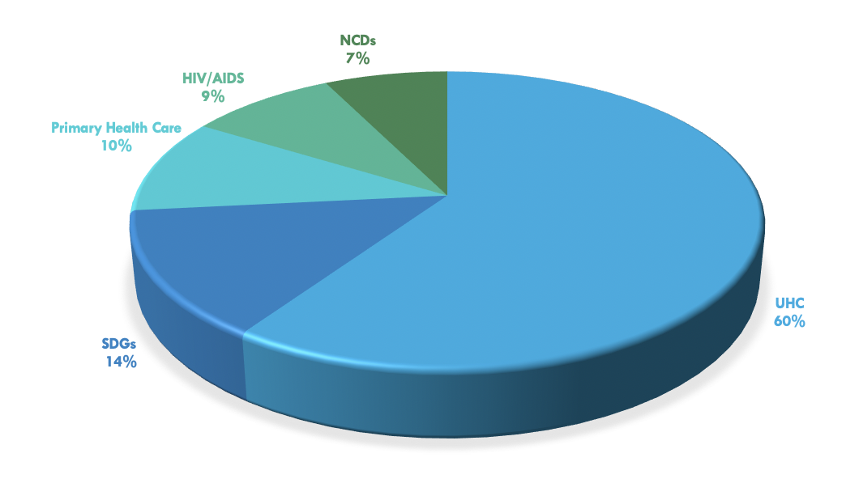
World Health Organization: Importance of Community Engagement in the Universal Health Coverage 2030 Initiative
Geneva, Switzerland
Amanda Abraham, M.P.H. Candidate in collaboration with Isabelle Wachsmuth, World Health Organization Department of Safety and Security
summary
Outcomes and evaluation
  One of many initiatives the WHO has been working on is Universal Health Coverage 2030 (UHC2030). As part of the Sustainable Development Goals (SDGs), all UN Member States have agreed to try to achieve UHC by 2030.
  The mission of UHC2030 is to accelerate progress towards UHC through strengthening health systems and to attain the highest possible level of health for all people.
This practicum was successful in gaining more knowledge and understanding of UHC.
This was addressed through an assessment of the add value of UHC multi-stakeholders through a review of the current UHC literature and stakeholder statements, creation of metrics and spreadsheets, along with the development the case study for the policy briefs.
Project Purpose
Interpretations
Goals and Objectives:
The overall goal was to share knowledge to member states, participants, and all stakeholders who would implement strategies to achieve UHC
Identify the best strategies of communication to engage different types of audience
Identify and test innovation knowledge management strategies with partners and member states
Participate and contribute to assess the add value of multi-stakeholder initiative to foster UHC
An important lesson learned was recognizing that achieving UHC requires great effort from many stakeholders, especially the community itself who are crucial in this initiative and will help create a sustainable program.
Table 1. The many ways in which involving the community is important.
Ongoing challenges include understanding stakeholders’ motivations that ultimately impact their support and the success in achieving UHC.
Structure of Project
Contribute toward UHC2030 through evaluation of stakeholder statements
Review of UHC and community engagement literature
Develop case studies on successful implementation through community engagement
Identify important factors to include in policy brief on achieving UHC
References
www.uhc2030.org/un-hlm-2019/uhc-statements/
www.who.int/health-topics/
Figure 1. The 5 leading topics of concern to UHC2030 stakeholders
Acknowledgements
Thank you to the Vanderbilt MPH program, Marie Martin and my practicum director, Brad Hawkins for guiding and supporting me through the whole practicum process. I would also like to give a special thanks to Isabelle Wachsmuth, my supervisor at the WHO for this incredible opportunity and experiences that I will cherish especially as I start my public health career. Thank you to Joey Starnes and Miller Morris who provided valuable advice and helped me plan and prepare for my practicum experience at the WHO.

