Slide 1

Reducing Maternal Mortality in Haiti by Improving Access to Surgery
Team 9
Colette Abah, B.Sc. (Ph.D. Candidate)
Sade Arinze, M.D. (MPH Candidate)
Selorm Dei-Tutu, M.D. (MPH Candidate)
Adoma Manful, B.A (MPH Candidate)
Miller Morris, B.A (MA Candidate)
N. Abimbola Sunmonu, M.D, Ph.D. (Neurology Resident)

Slide 2

Aims for Proposal
Improve maternal health outcomes by expanding access to safe surgery in Haiti.
5-year reduction of maternal mortality by 7%.
Create pilot initiatives over a 3-year period with funding of $500,000 USD per year.
Notes:
ADOMA: make spaces between bullets even

Slide 3
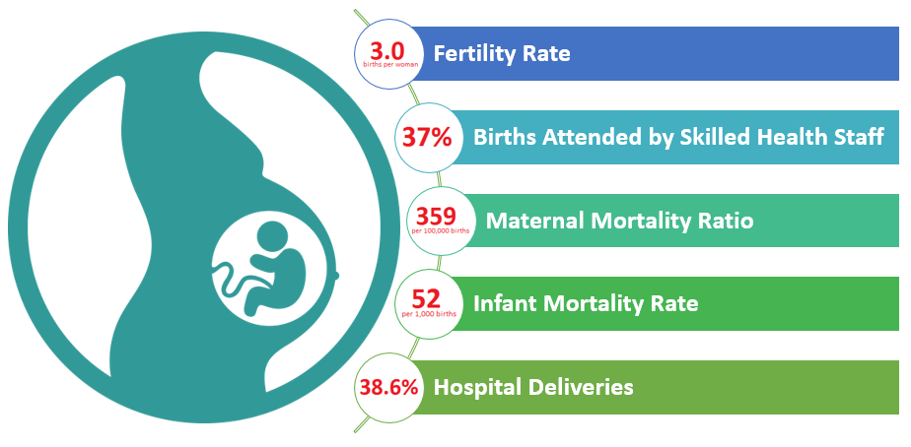
The Challenge
Surgical burden
  Few skilled health workers
  Major facilities clustered in the capital
  Mountainous terrain
  Low health literacy
  Surgery not easily affordable
⇒ High MMR and poor surgical outcomes
Sources: WHO, World Bank, MSPP
Notes:
The problem that needs to be solved: Reduce maternity mortality and mortality

Slide 4
Our Response
Selected Interventions
Human Capacity
Education
Access
Sustainability
M&E and Scale Up
Proposal Criteria
Specific
Measurable
Achievable
Relevant
Timely
⇒ MAXIMUM IMPACT
Notes:
For maximun impact we needed a proposal that was S.M.A.R.T. feasible in the time alloted, maxiu
There are several contributors nd factors.
We have limited time and funds so we chose
-rural areas
-4 key aspects to intervene
-

Slide 5
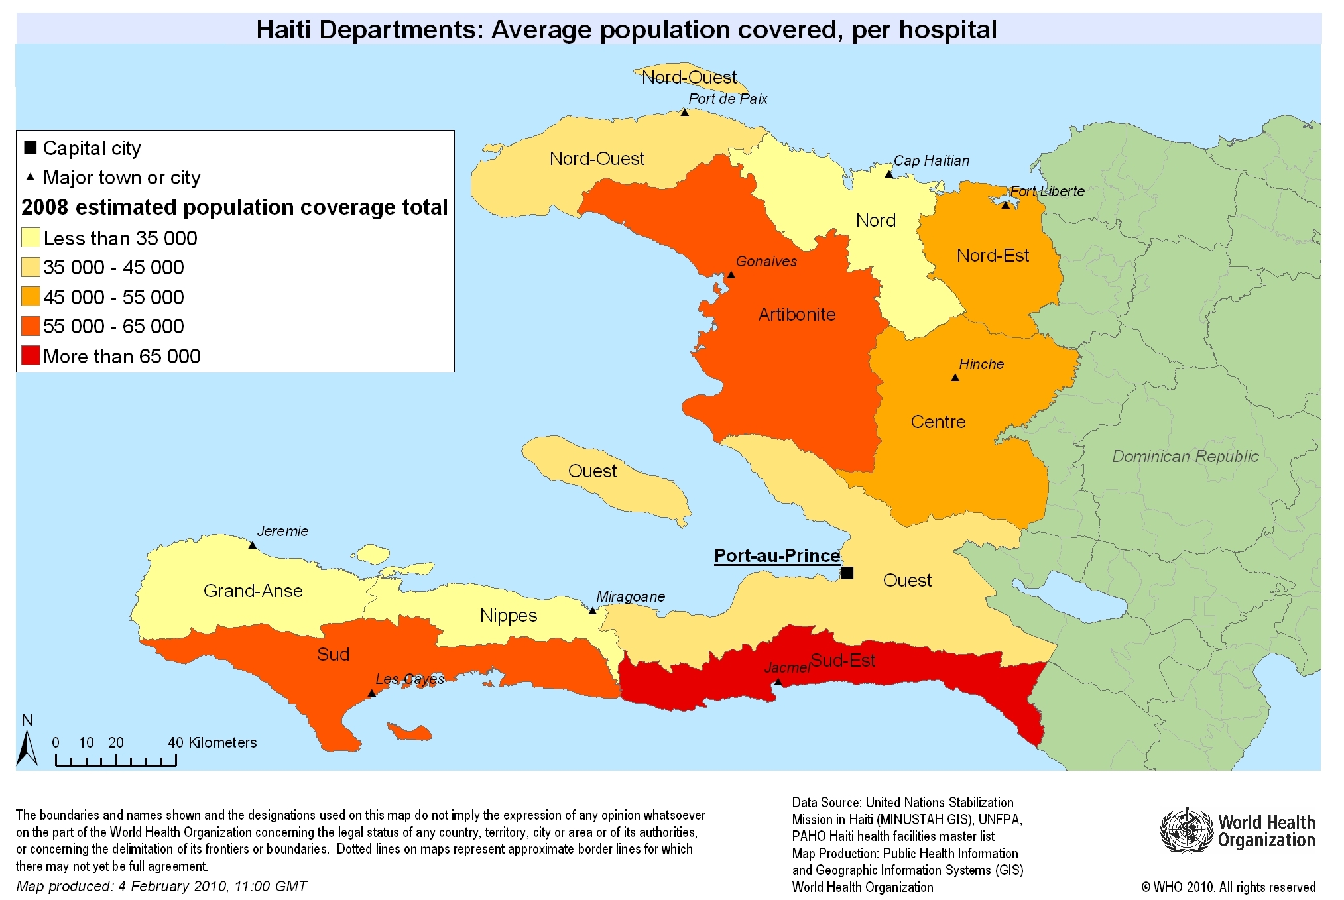
Rural focus: Selected Sites
http://www.who.int/hac/crises/hti/maps/haiti_population_per_hospital_district_4feb2010.JPG?ua=1
Notes:
ADOMA: make all titles the same on each slide (size and font)
The 3 provinces in the speaker notes: “Latibonit”, Sud and Sud-East
These regions are particularly underserved and highly populated, so we can make the most impact

Slide 6
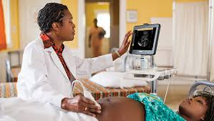
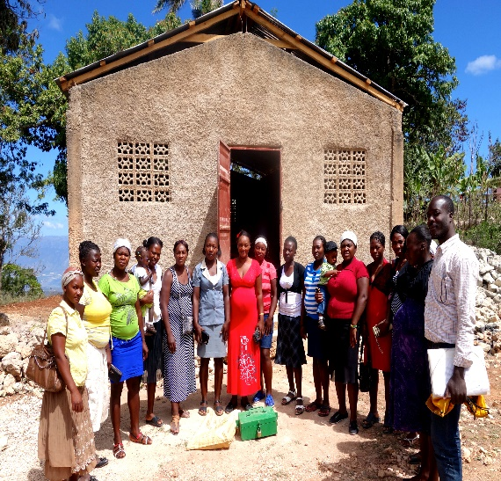
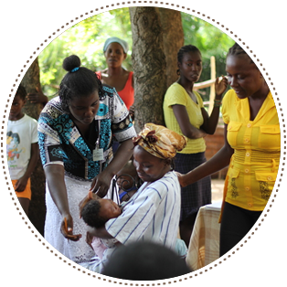
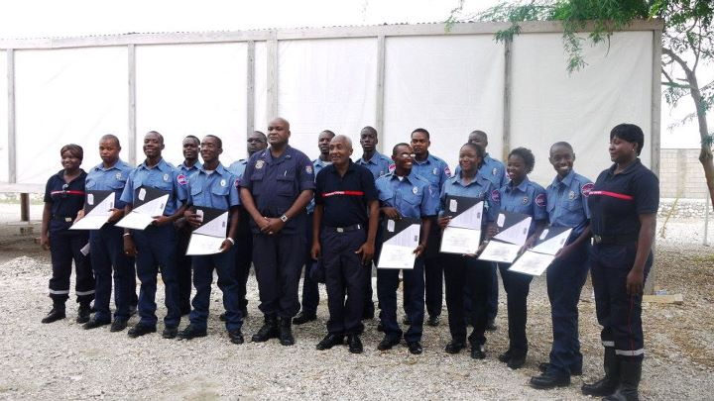
Human Capital and Education
Tuition Scholarship + Work Service
Community Health Worker Initiative
Community Pledge
Increased training and retention of personnel
Increased health literacy in community

Slide 7


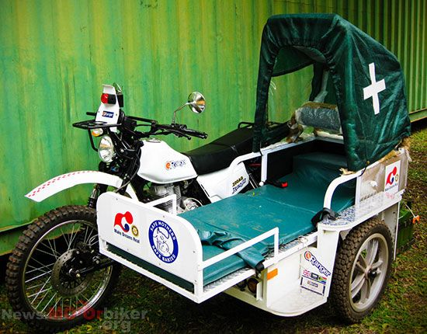
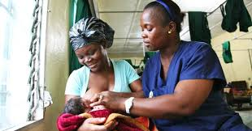
Motorcycle Ambulance
Increasing Access
Mobile “911” service
Patient Navigators
Improved accessibility to hospital and services

Slide 8


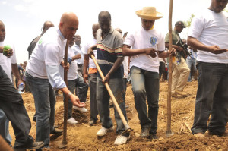

Sustainability & Continued Funding
Rainy Day Fund
Community Empowerment
Entrepreneurship Fair
Fosters Community Contribution to Local Business and Healthcare Projects

Slide 9

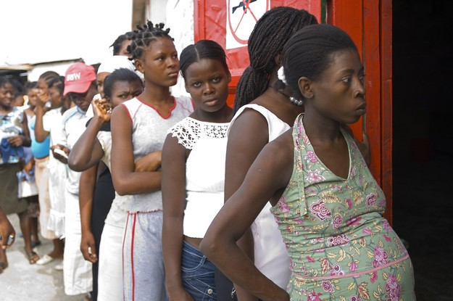


Monitoring, Evaluation and Scale Up
Data Collection & Analysis
Quality Improvement
Implement nationally
Adapt + expand to urban settings
Expand under-served states
3 proposal sites
Establish a Data Repository for Community-led Improvement

Slide 10
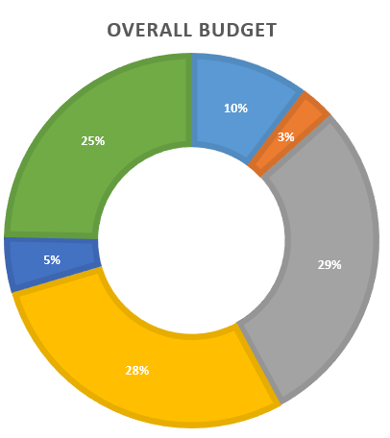
Budget & Timeline
Y1
Y2
Y3
Y4
Y6
Y5
Y7
Community Health Worker
Tuition Scholarships
Work Service Salary
Entrepreneurship
1.46M
Research Activities
Scale Up

Slide 11



STRENGTHS (+)
    • Evidence-based approach
    • Community participation, partnership and collective investment in development
    • Use of existing resources and infrastructure
    • ↑ employment of locals, ↑ income revenue
WEAKNESSES (–)
    • Full cohort of providers not available till year 5
    • Free care model may be challenging to sustain
OPPORTUNITIES (+)
    • Expand post-training work service into a national program
    • Scale up Community Health Worker Initiative nationally
THREATS (–)
    • Pre-exisiting reluctance to utilize healthcare services
    • Socio-political instability; insufficient healthcare budget,
    • “Brain drain”, poor renumeration for medical staff

Slide 12
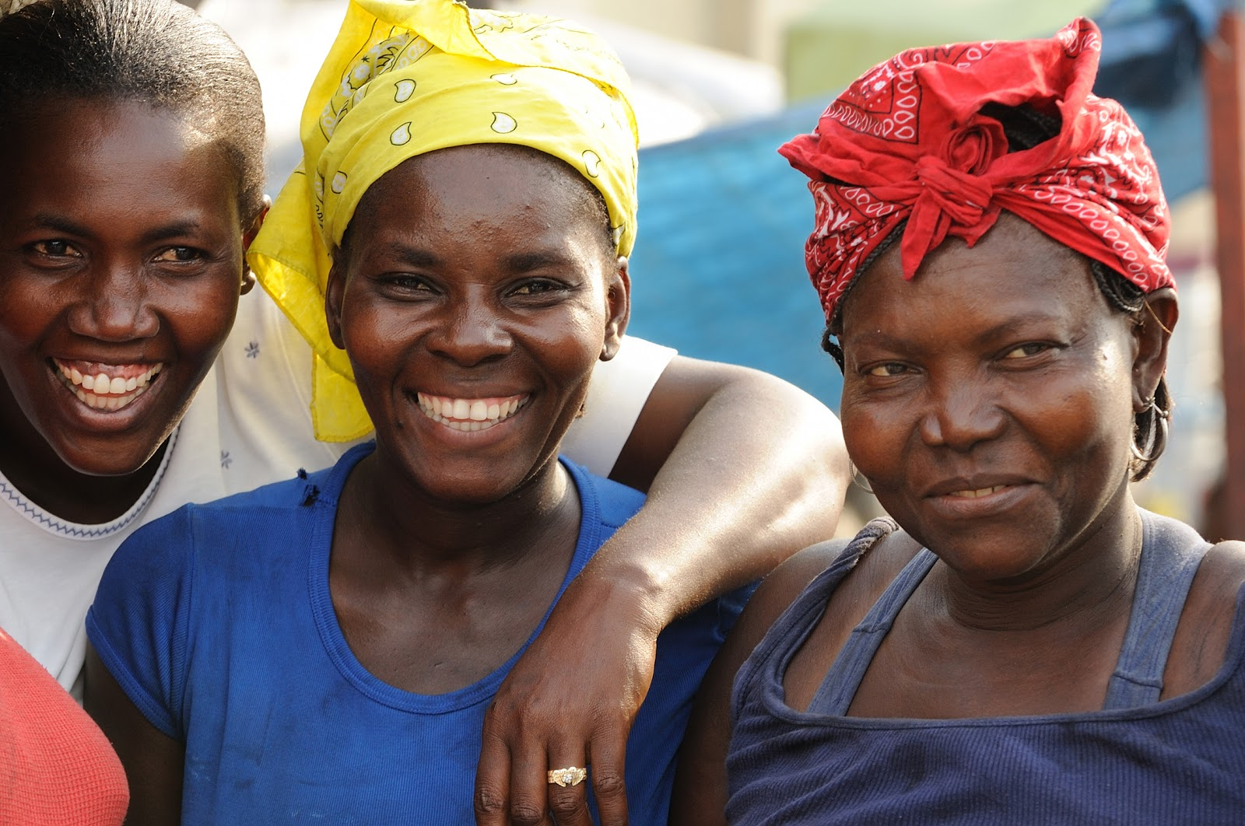
Thank You & Questions

Slide 13
Reference List
Al, Rebecca Winter Et. "LEVELS AND TRENDS IN NEWBORN CARE SERVICE AVAILABILITY AND READINESS IN BANGLADESH, HAITI, MALAWI, SENEGAL, AND TANZANIA." (n.d.): n. pag. USAID. Web. 9 Feb. 2017.Corley, Anne-Marie. "Why Haiti's Cellphone Networks Failed." IEEE Spectrum: Technology, Engineering, and Science News. N.p., 19 Feb. 2010. Web. 10 Feb. 2017.
"Communications between 'first Responders' in Haiti to Be Strengthened – UN Agency." UN News Center. United Nations, 16 Feb. 2010. Web. 10 Feb. 2017.
"ERanger Ambulance." The Harvard Volunteers in Europe (n.d.): n. pag. The ERanger Ambulance. ERanger. Web.
Gage, Anastasia J., and Marie Guirlène Calixte. "Effects of the physical accessibility of maternal health services on their use in rural Haiti." Population studies 60.3 (2006): 271-288.
"Global Health Expenditure Database." Global Health Expenditure Database. N.p., n.d. Web. 10 Feb. 2017.
"Grants." W.K. Kellogg Foundation. N.p., n.d. Web. 10 Feb. 2017.
Hofman, Jan J., et al. "Motorcycle ambulances for referral of obstetric emergencies in rural Malawi: Do they reduce delay and what do they cost?." International Journal of Gynecology & Obstetrics 102.2 (2008): 191-197.
"HTI." UNICEF DATA. N.p., n.d. Web. 10 Feb. 2017.
Income Generating Programmes. Digital image. APPEAL Training Materials. UNESCO, n.d. Web.
"In Haiti, Emergency Clinics Help Reduce Maternal and Neonatal Deaths." UNICEF. N.p., n.d. Web. 10 Feb. 2017.
Leach, F., & Sitaram, S. (2002). Microfinance and women's empowerment: A lesson from India. Development in Practice, 12(5), 575-588.
"Les Transports." Ministère Des Travaux Publics, Transports Et Communications. Ministère Des Travaux Public, n.d. Web. 10 Feb. 2017.
"Making Pregnancy & Childbirth Safer in Uganda & Zambia: Annual Report 2013." Saving Mothers, Giving Lives, n.d. Web.

Slide 14
Reference List
"Maternal Mortality Ratio (modeled Estimate, per 100,000 Live Births)." Maternal Mortality Ratio| Data. N.p., n.d. Web. 10 Feb. 2017.
Ssebunya, Rogers, and Joseph KB Matovu. "Factors associated with utilization of motorcycle ambulances by pregnant women in rural eastern Uganda: a cross-sectional study." BMC pregnancy and childbirth 16.1 (2016): 46.
"The World Factbook: HAITI." Central Intelligence Agency. Central Intelligence Agency, 12 Jan. 2017. Web. 10 Feb. 2017.
"Training & Sustainability." St. Boniface Haiti Foundation. N.p., 01 Feb. 2017. Web. 10 Feb. 2017.

Slide 15
Appendices

Slide 16
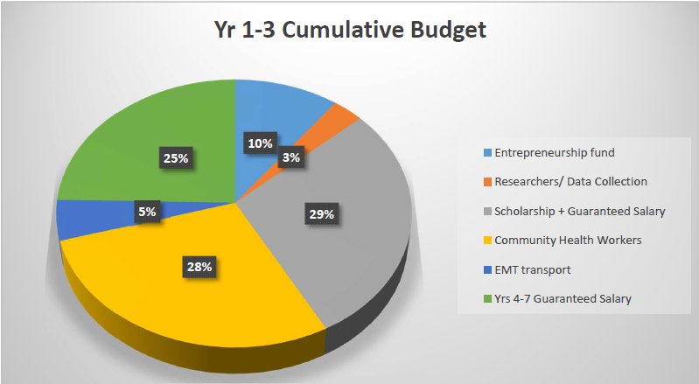
Appendix A: Overall budget

Slide 17
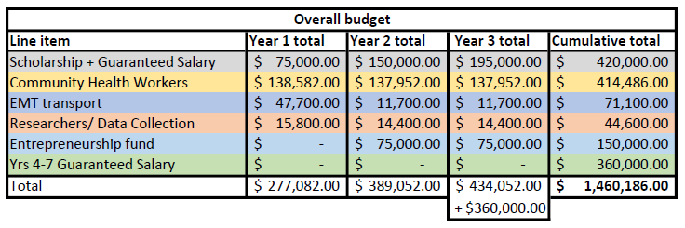
Overall Budget

Slide 18
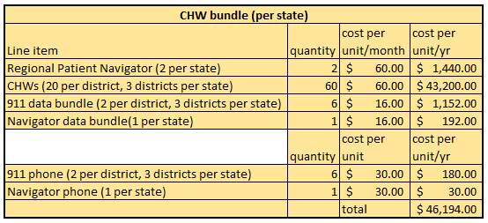
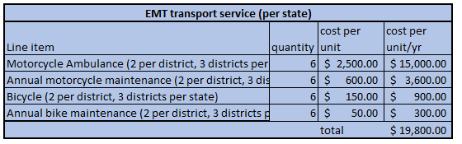
Budget -specifics

Slide 19
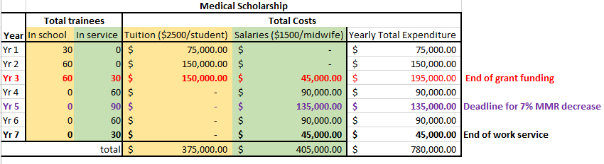
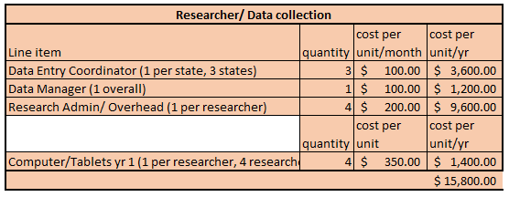
Budget -specifics

Slide 20
Appendix B: Logic Models

Slide 21


Priority 1: Human Capital and Education
Medical Tuition Scholarship
Established training facilities
Subsidized education
3yr commitment
Education component
Trained and accredited medical staff
Increased training and retention of healthcare personnel
Registry of skilled workers
IMPACT
Haiti has a skilled medical workforce
Sustained pipeline of healthcare workers in rural Haiti
Notes:
R- Established training programs such as SONU, HUM and INSFS already exist and train people.
A- we will subsidize 2 yrs education for nurses and midwives. As a result they will be required to serve in the three rural communities of focus for 3 years.
There will be an educational component to their curriculum where they will be required to create content to educate the communities in which they serve

Slide 22
Priority 1: Human Capital and Education
Community Health Worker Initiative
Community members
20 trained community health workers
Social media outreach
Trained, interdisciplinary and certified community health workers
Ability to transport patients to nearest hospital
Improved access to emergent surgical attention
Basic healthcare and triage to be provided at the community level
IMPACT
Reduced maternal morbidity and mortality in rural Haiti
Increased community engagement in their health
Increased knowledge on surgical emergencies
Notes:
ADOMA: distinguish between the priorities easily in the slide titles
R - We will ask NGOs and communities to provide a room/location to serve as the operations base for these CHW
A- 20 community health workers from the rural communities selected. 5 of them will be nominated by their communities and 15 of them apply.
Existing traditional birth attendants will be invited to join this cohort of CHW if interested. These CHW will focus on pregnant women but will also serve the rest of the community. They will be able to provide basic healthcare such as minor procedures, post-op care; will triage patients in need of emergent care and get them to the nearest hospital. There will be 2 patient navigators in each hospital who will be in contact with each CHW team, and help patients navigate their way through the hospital when they get there.
The social media outreach will take advantage of existing SMS and other messaging services e.g.whatsapp to provide health educational material to communities

Slide 23
Priority 1: Human Capital and Education
Community Pledge
Community groups and leaders
Community spaces
Rainy day fund
Provision of space
Central community hub space
Dedicated permanent space in 3 years per community
IMPACT
Community engagement and sense of ownership
Notes:
ADOMA: make each priority stand out by colour-coding the slides, so that each one has a different colour
R- community members, groups, leaders and NGOs
A- communities (groups, NGOs, churches etc) to provide a common space to serve as a central hub for CHW to base their operations out of. They should/ would also provide space for them to give their trainings to their communities
location to be used for trainings and activities
one small room/space for central hub for the CHW activities like internal trainings etc and a common community space for outreaches and seminars

Slide 24
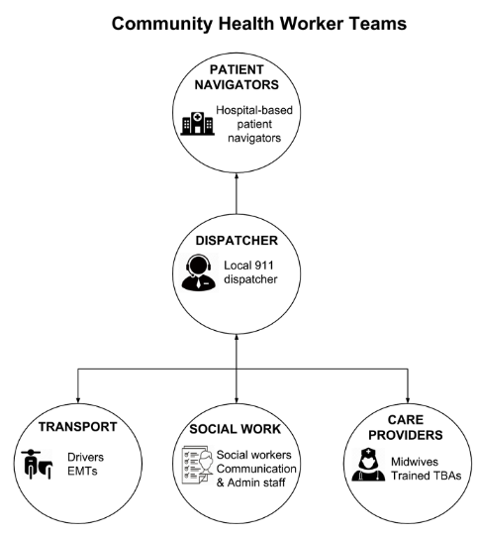
EMTs

Slide 25
Priority 2: Increasing Access
Local “911” and Ambulance Service
-Dedicated “911” line
-Health care tips and alerts.
-Community transportation routes
IMPACT
-Community health workers
-Existing phone networks (Whatsapp)
-Vehicles, modified motorcycles, and bicycles
-Community access to CHWs.
-Faster access to medical services.
-Mapped out routes to hospital.
-Reduced maternal morbidity and mortality by 4% in 2 years.
-Reduced maternal morbidity and mortality by 7% in 5 years.

Slide 26
Priority 3: Sustainability and Continued Funding
Income-generating models, including:
- UNESCO Entrepreneurship Model
- Kudumbashree model)
Establish “Rainy Day Fund”
Focus groups to identify & prioritise feasible business ideas
Entrepreneurship fairs
Microcredit loans
Engagement of local businesses
IMPACT
Revenue generation
Vocational skill development
Capacity building
Increase in local employment and income-generating ventures
Increased community investment in these initiatives
Locally and sustainably employed rural Haitians
Continued entrepreneurial spirit in rural Haiti
Long term and locally sourced revenue to self-sustain community health ventures
Notes:
“Rainy Day Fund” = medical insurance composed of financial contributions from the community (associations/ cooperatives of market women, farmers, etc.)
These groups are well-organised already. They can also exert some peer-pressure to encourage other people to contribute.
The Rainy Day Fund includes income from any entrepreneurship ventures and goes toward medical care and the scholarship
Money from the entrepreneural ventures will help sustain CHWs after the grant ends
UNESCO’s Starting My Own Small Business was published to respond to a lack of technical and vocational education materials.
It was designed with input from technical and vocational education policymakers from 11 East African countries.
provides supplementary knowledge to young people so that they can acquire an entrepreneurial mindset and the knowledge to set up a small business. The objective is to motivate youth and adults who have not received a formal education and to equip learners with the rudimentary skills and knowledge to engage in some form of self-employment.
40-page facilitator's guide and accompanying participant's workbook
Kudumbashree model in India:
female-oriented, community-based, poverty reduction project of the Government of Kerala, an Indian state
Encourages community participation, organisation, collective investment (e.g. microfinance schemes), capacity building, personal and professional development (entrepreneurship
Focuses on women’s empowerment through self-help groups, entrepreneurial and other activities to promote their leadership in development initiatives.

Slide 27
Priority 3: Sustainability and Continued Funding
Kudumbashree Model in India:
  female-oriented, community-based, poverty reduction project of the Government of Kerala, an Indian state
  Encourages community participation, organisation, collective investment (e.g. microfinance schemes), capacity building, personal and professional development (entrepreneurship
  Focuses on women’s empowerment through self-help groups, entrepreneurial and other activities to promote their leadership in development initiatives.
Our model:
  Y2 and Y3 (and hopefully continued with other funding): a total of $75,000/year is designated to 3 state, at $25,000 per state
  Each state spends $5,000 on putting on the fair itself
    A community event with food, entertainment, clean space -- using these funds to pay community members to prepare for the fair
  Each state has $20,000 to invest in local entrepreneurs and their ideas
    Pre-fair focus groups to decide how this money will be allocated. States may choose to give one winner the totality of $20,000, or to split the winnings between multiple people/teams
    If states decide to split the winnings between 2+ people/teams, at least 50% of the winners have to be women or women-led teams
      We hope by encouraging women to pursue careers, they may wait to have children, which could in turn also be consequential for our ultimate goal of reducing maternal mortality (Leach and Sitaram, 2002)
  These stipulations follow the tenets of the Kumdumbashree Model but are tailored to meet the needs of rural Haitian communities
A proportion of profits, to be determined after businesses begin their income-earning trajectory, made by these entrepreneurs and their businesses will be allocated into a Rainy Day Fund that provides sustained and locally-sourced financial resources to continue Medical Scholarship Funds and Community Health Worker salaries and expenditures within their state.

Slide 28
Priority 4: Monitoring, Evaluation, and Scaling Up
Regional project managers in charge of data collection and analysis
Community feedback
Quarterly review sessions
Quality assurance and quality control
Distribution of data and outcomes to communities and stakeholders
Pre and Post data
Project scalable to other rural areas and adapted to urban areas
IMPACT
Documented reduced maternal mortality
Notes:
We will hire a regional project manager in charge of data collection, management, and analysis.
Communities provide feedbacks are obtained through 911 calls and whatsapp group. (They have the option of dialing #2 to leave feedback, and #3 to register for whatsapp group)
Quarterly reviews with local community health workers
The data collected throughout the project will be distributed to the community and stakeholders

Slide 29
Proposal Summary
1: Medical Scholarship
→ ↑ availability of providers, ↑ quality of care
2: Community Health Worker Initiative
→ ↑ knowledge, ↑ use of care, ↑ employment
3: Local “911” + ambulance service
→ ↓ travel time, ↑ access to care
4:Entrepreneurial Funding
→ ↑ employment, ↑ revenue

