Slide 1
OACS Service vehicles
2016-2017

Slide 2

In order to drive an OACS vehicle you must complete the following:
Go to Learning Exchange and in the course box type ”Driver Orientation” and click “Enroll” you will receive a email stating that you have been enrolled.
  Please complete the PowerPoint question and answer.
  Complete the “Driver Authorization Application” and the “Consent and Disclosure” application. Holly Jones has these at her desk in the OACS office 305 Sarratt|Rand Hall
  Holly Jones will also need a copy of the driver’s license in order to complete the authorization.
  Please bring $10.00 cash or check
  Holly Jones submits this information to risk management and once she gets confirmation, the student will be able to drive an OACS vehicle.
  New Vanderbilt policy- All students driving for Vanderbilt events whether it is an OACS vehicle or their personal vehicle, they MUST complete the driving module.

Slide 3

Renting an OACS Vehicle
Once the student is a certified driver, they can now rent an OACS vehicle for service.
The student will need to go on EMS to book a vehicle. OACS has 4 cars and 2 vans. Select the vehicle that best suites your needs.
Once you submit your request, wait to get an email staying that your vehicle request has been approved. This may take over 24 hours.

Slide 4
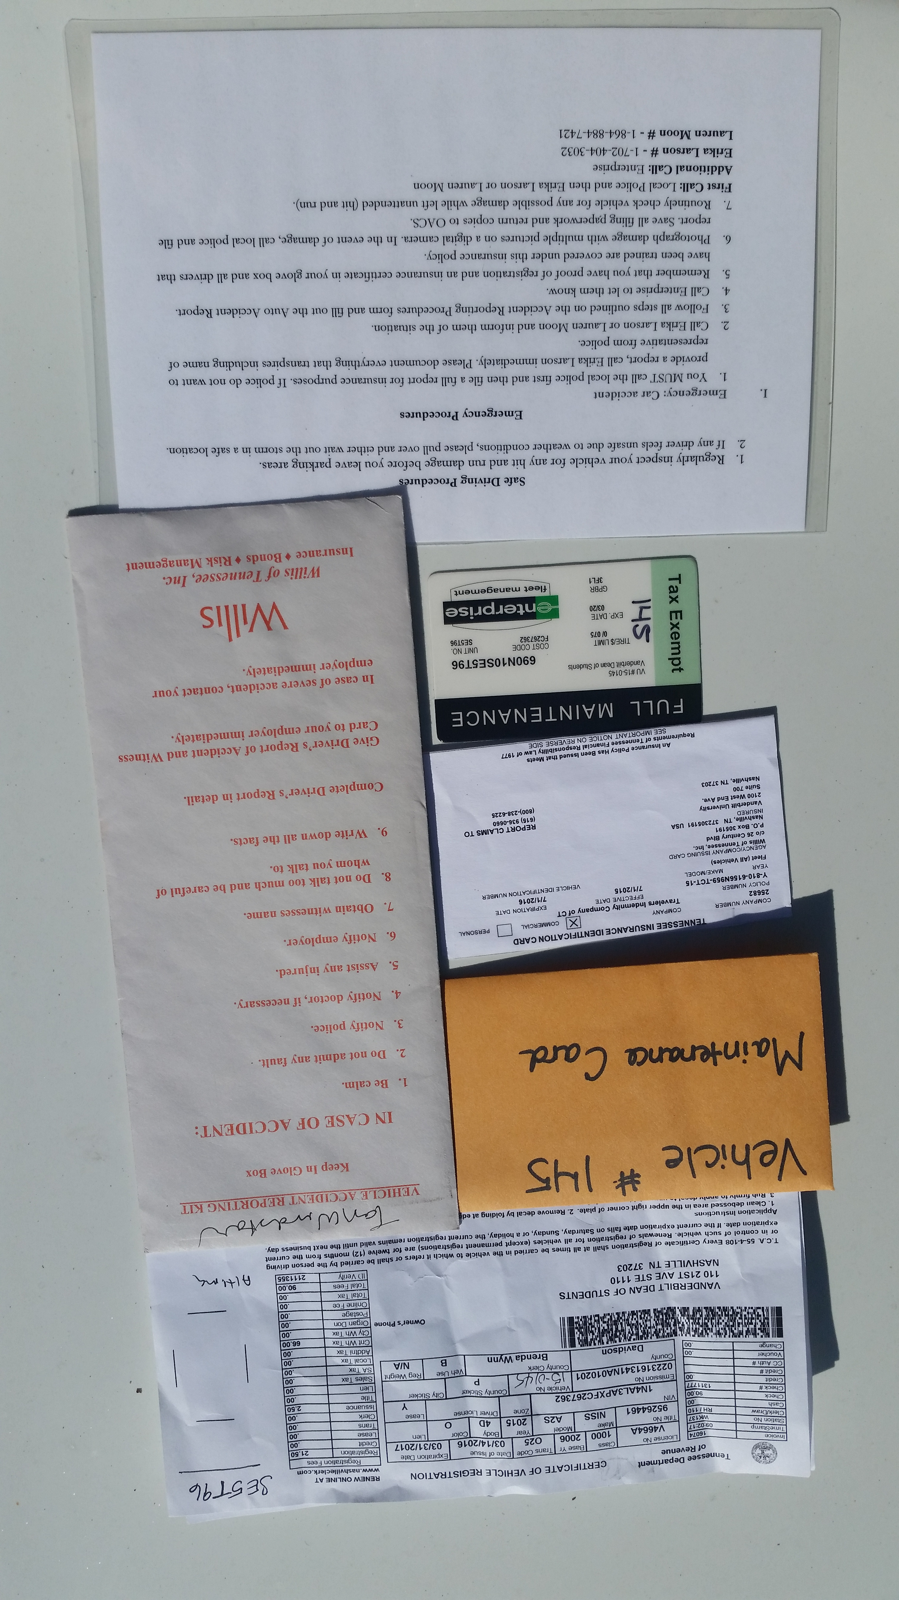
Using OACS Vehicles
Each of the OACS vehicles will have the following items:
  A laminated emergency sheet with directions to follow in case of
  an emergency and numbers to call.
  A pen
  Vehicle accident reporting kit- This envelope contains reporting
  tools for the student to use when documenting an accident.
  Little orange envelope with:
    Enterprise Maintenance card- This card can be used if the vehicle gets a
    flat tire or the vehicle breaks down.
    Insurance card
    Vehicle registration

Slide 5
Using OACS Vehicles
Each of the OACS vehicles have a small plastic tote containing:
  Windex
  Paper towels
  Ice scrapper
  Please use these items when you feel like it is necessary.
  Two of the vehicles are parked under the trees and they have tarps on the windshield to protect the windshield from the sap that falls from the trees. Please remove this before you drive the vehicle and please put the tarp back on the windshield when you are done using the vehicle.

Slide 6
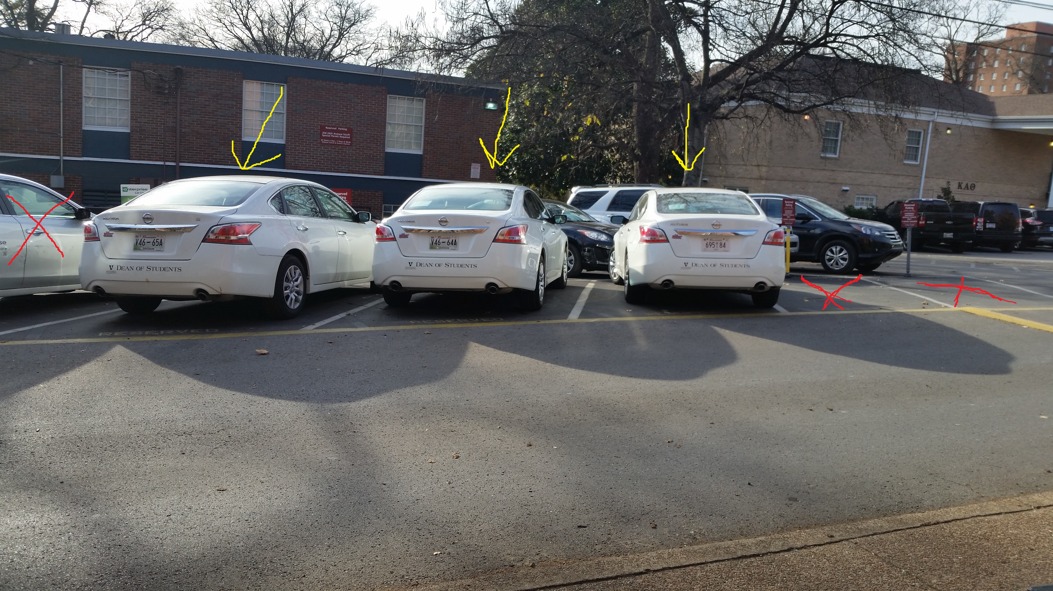
Where to Park the Vehicles
The Parking lot is located on West Side Row off of Vanderbilt Place.
Please park the cars in the three designated spots for “Office of Active Citizenship and Service”
These parking spaces are too small for the vans, so please only park the cars in these spots.

Slide 7
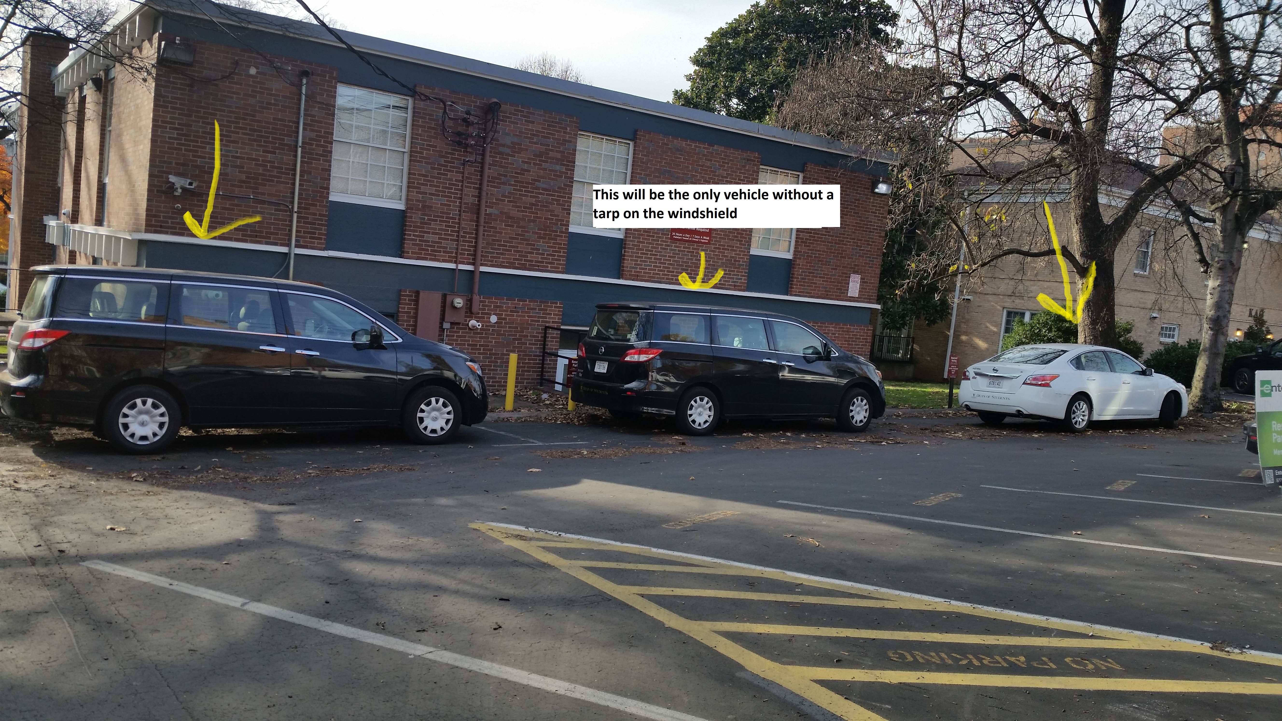
Where to Park the Vehicles
Please park the vehicles as shown in the picture.
The vehicle in the front and in the back should be the only two with a tarp because they are parked closer to the trees.

Slide 8

When and where to pick up the keys
The vehicle keys will be located in a black box on Holly Jones desk.
  When the student picks up the key they will need to pick up the form beside the box and make sure they fill it out when they return the key.
The keys will be in an orange envelope with the students name on it, the envelopes are in alphabetical order by the students last name.
If the student has a vehicle assigned to them for the weekend, they will need to pick up their key between 3:00pm-4:30pm on Friday.
If a student is done using the vehicle after hours they will turn their key into the Sarratt box office.

