Slide 1
Has Joint Scaling Solved the Achen Objection to
Miller and Stokes?
JEFFREY B. LEWIS
CHRIS TAUSANOVITCH
UNIVERSITY OF CALIFORNIA – LOS ANGELES

Slide 2
MOTIVATION
Achen (1977,1978) argues that correlations are not good measures of representation.
Public opinion may have a different structure than legislative position-taking, and multiple measures are needed (Converse 1964, Ansolabehere, Rodden and Snyder 2008)
Joint scaling proposes to solve these problems (Bafumi and Herron 2010)
Core identifying assumptions have not been tested
Notes:
Miller and Stokes was the launching off point.

Slide 3
Two TAKEAWAYS
In the context of two prominent examples, the core assumption underpinning joint scaling fails statistical tests
From a statistical perspective, if we are willing to accept the restrictive assumptions implied by these joint scaling models, we must also accept a wide range of relative locations for legislators and their constituents
Notes:
We will talk at the end about where this leaves us

Slide 4



THE PERILS OF THE CORRELATION
A possible data generating process:
Now consider a measure of :

Slide 5


THE PERILS OF THE CORRELATION
What coefficients do we recover from the following model?
Not quite the ones we want
Notes:
Romer rosenthal

Slide 6
CONSTITUENT PREFERENCES
One solution is to directly compare the positions of legislators to the preferences of constituents
However, this comparison may or may not make sense
It assumes that ordinary people have the same sorts of preferences that legislators do
Notes:
We are going to make “same sort” more specific

Slide 7






THE MODEL
is person i’s response to question j
is the ideal point of person i
is the “discrimination parameter”
is the “difficulty parameter”
is the cutpoint
Notes:
This makes a function by which preferences translate into responses.

Slide 8
JOINT SCALING
The model defines a function that turns preferences into responses
This function varies by item
However, we can compare the preference of different groups if we can identify items with the same response function
Simple to implement: just make i the same

Slide 9
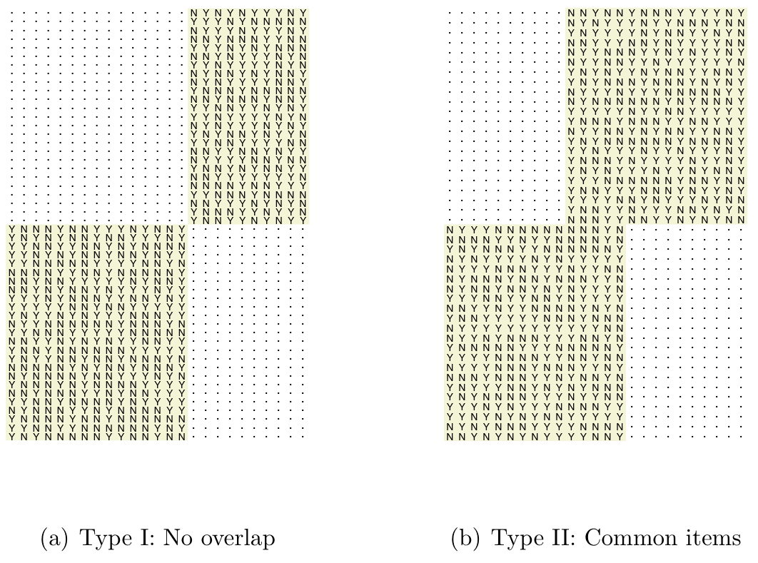
Joint scaling

Slide 10
What are the common items?
Roll call questions
Ask survey respondents to take positions on roll call votes
But these contexts are very different!

Slide 11
Different contexts
Different content
Different information levels
Different stakes
Different interpretation/understanding
Notes:
DIF. Authors have tried very hard, but conflicting goals

Slide 12
A TEST
If items do have common item response functions across group, then pooling the groups should not reduce the likelihood of the responses
“Joint” or constrained model: assume that some set of items is common
“Not joint” or unconstrained model: estimate the groups separately
Notes:
In order to do this test, you need more than one item

Slide 13
DATA
Jessee (2009):
  111 Senators
  5871 survey respondents
  27 common items
Bafumi and Herron (2010):
  629 elected officials (House, Senate, and President)
  8219 survey respondents
  17 common items
Common items are roll call questions

Slide 14
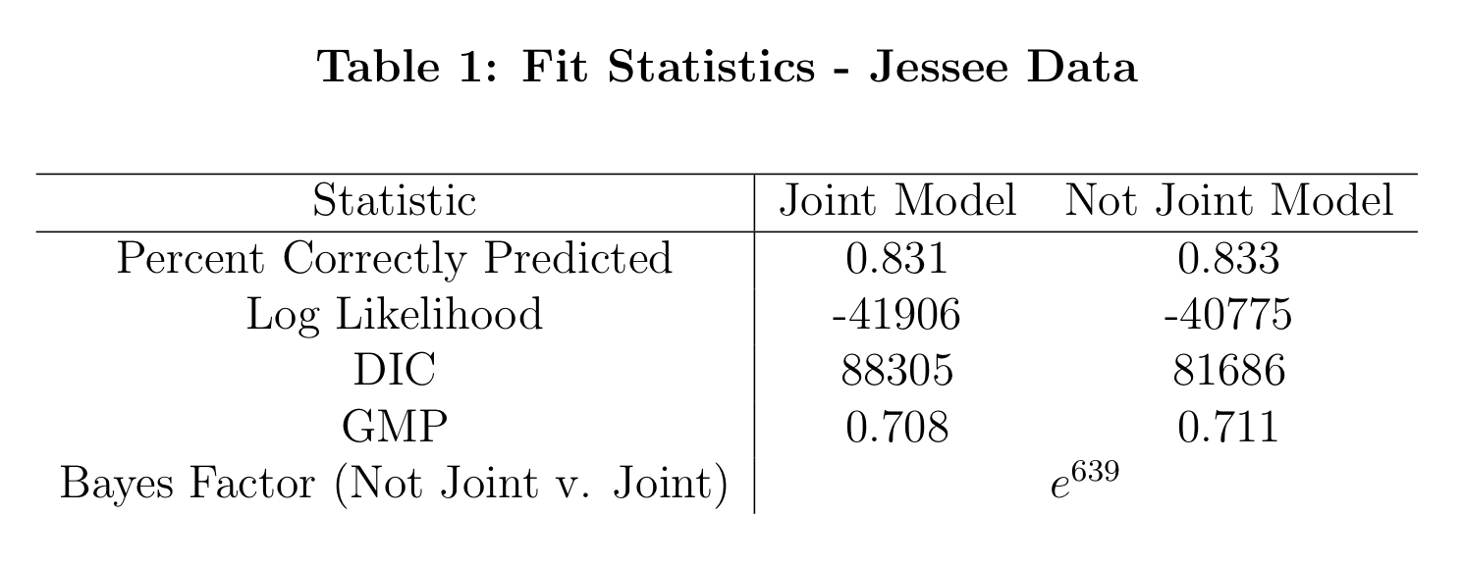
FIT OF THE TWO MODELS

Slide 15
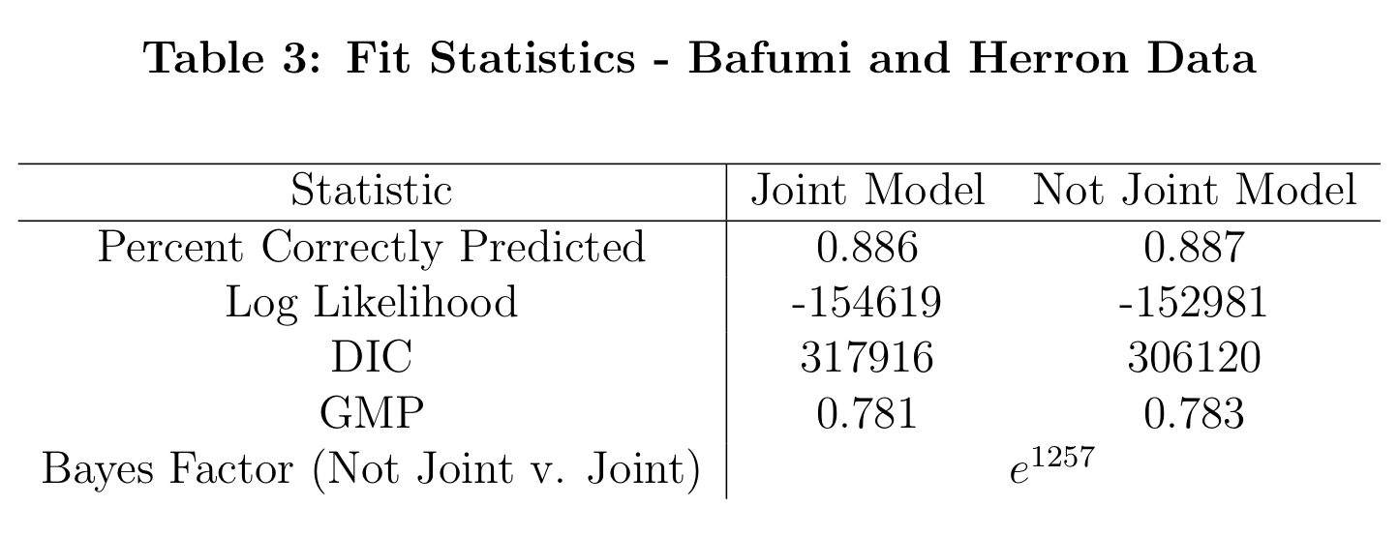
FIT OF THE TWO MODELS

Slide 16
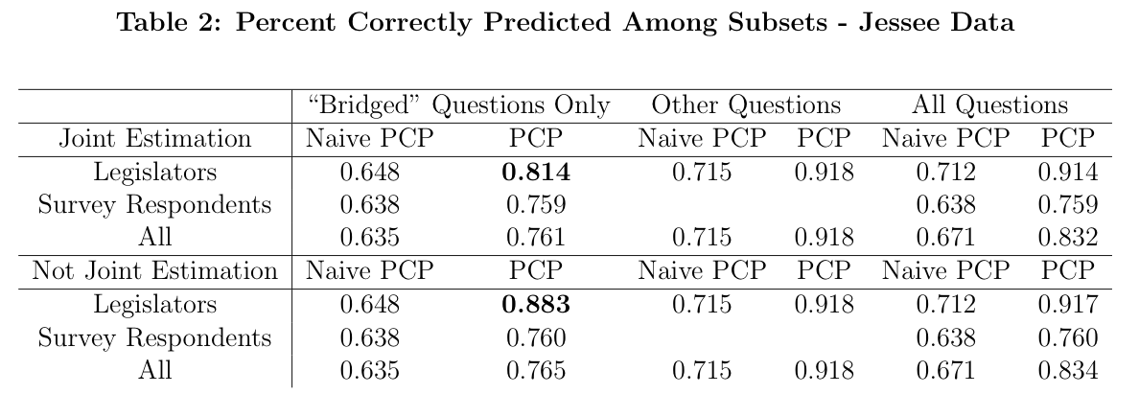
SOURCE OF POOR FIT

Slide 17
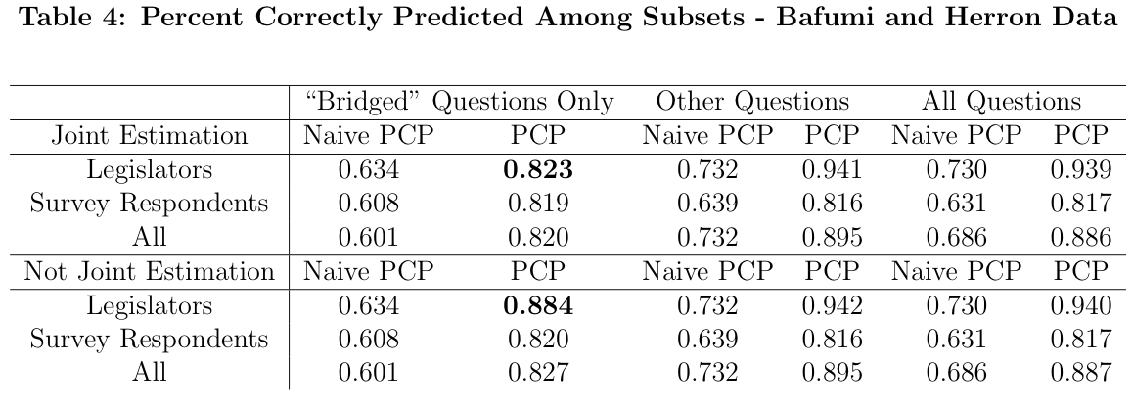
SOURCE OF POOR FIT

Slide 18
Another test
When the groups are separately scaled, the item parameters should be linear transformations of each other
Separate scalings should differ by only a stretch and a shift
As a test, we project estimates item parameters on each other and compare the posterior distributions

Slide 19
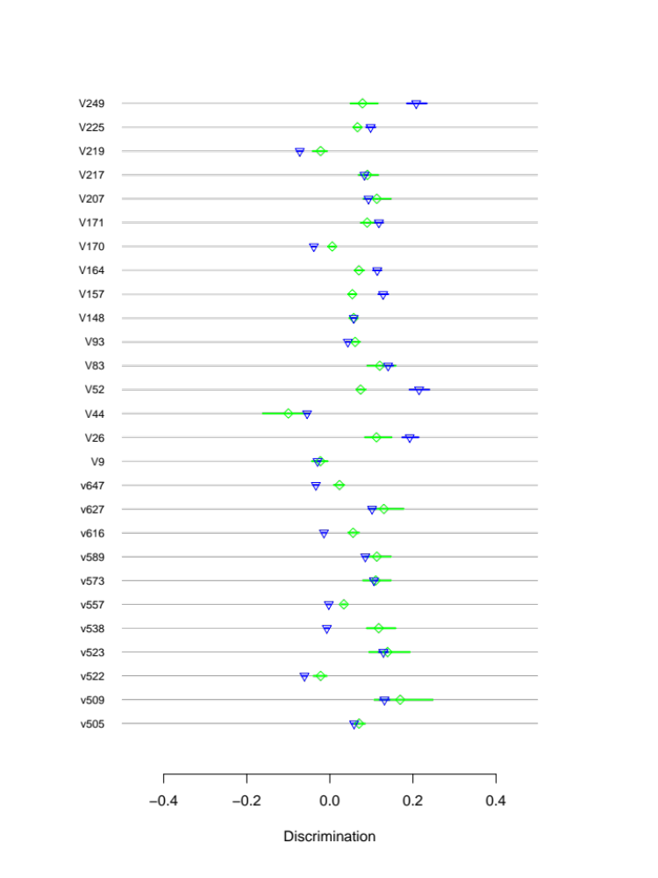
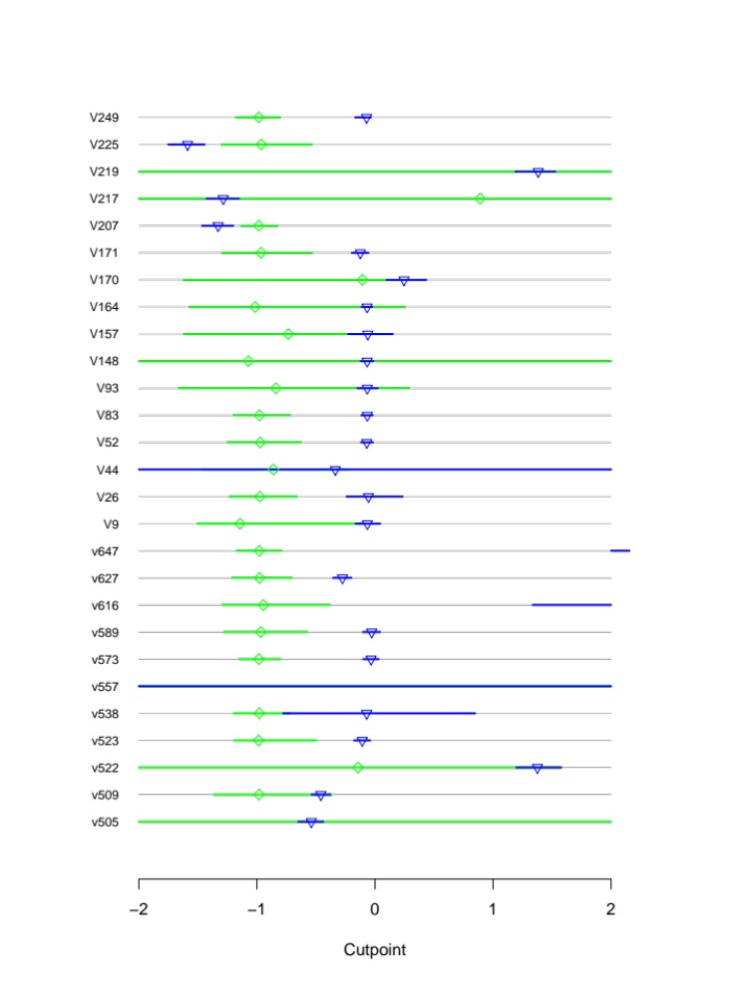
Another test – jessee data

Slide 20
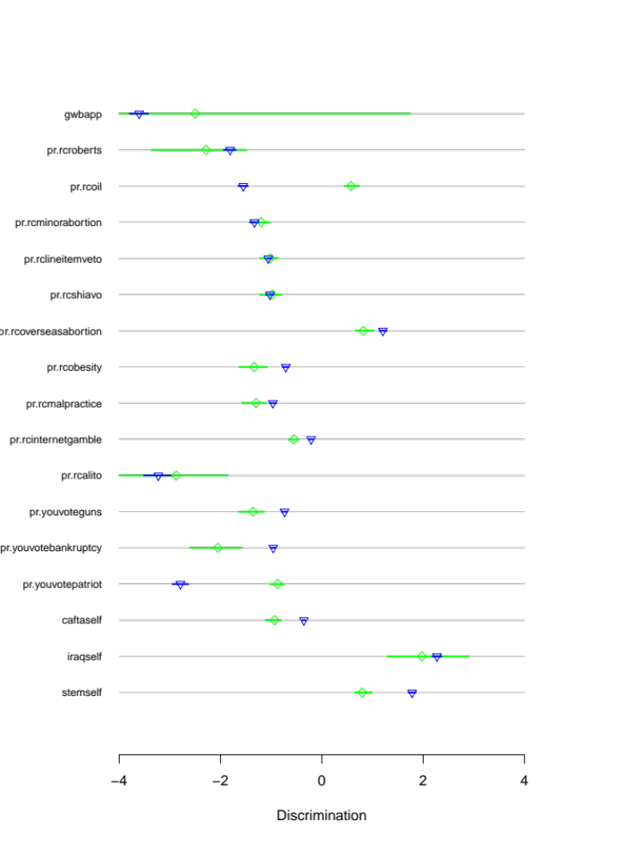
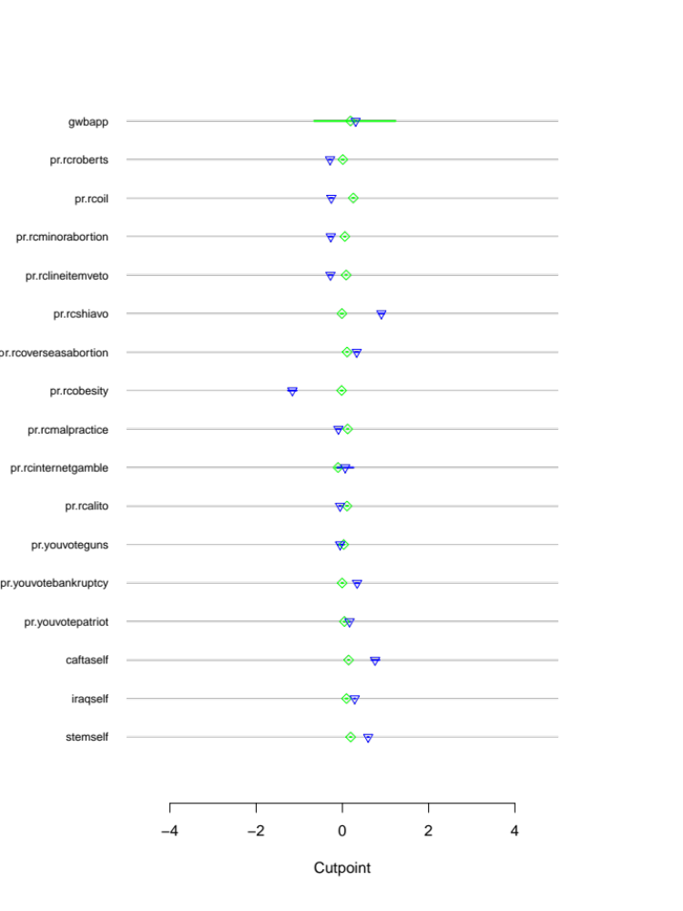
Another test – herron data

Slide 21
IMPLICATIONS
“Not joint” model greatly outperforms joint model
This occurs due to lower fit of the joint items
The common item parameter assumption is not correct for these data

Slide 22
How bad is this?
Are proximity comparisons with estimates from joint scaling still good approximations?
If item parameter assumptions are wrong, we cannot know. However, perhaps out standard was too strict.
If we are willing to accept this reduction in likelihood, what differences in the locations of the two groups should we be willing to accept?
Notes:
Ted Lowi: This is a test that only a chi-square test would reject
Is this just the fact that big data can reject everything? Small effect on classification

Slide 23
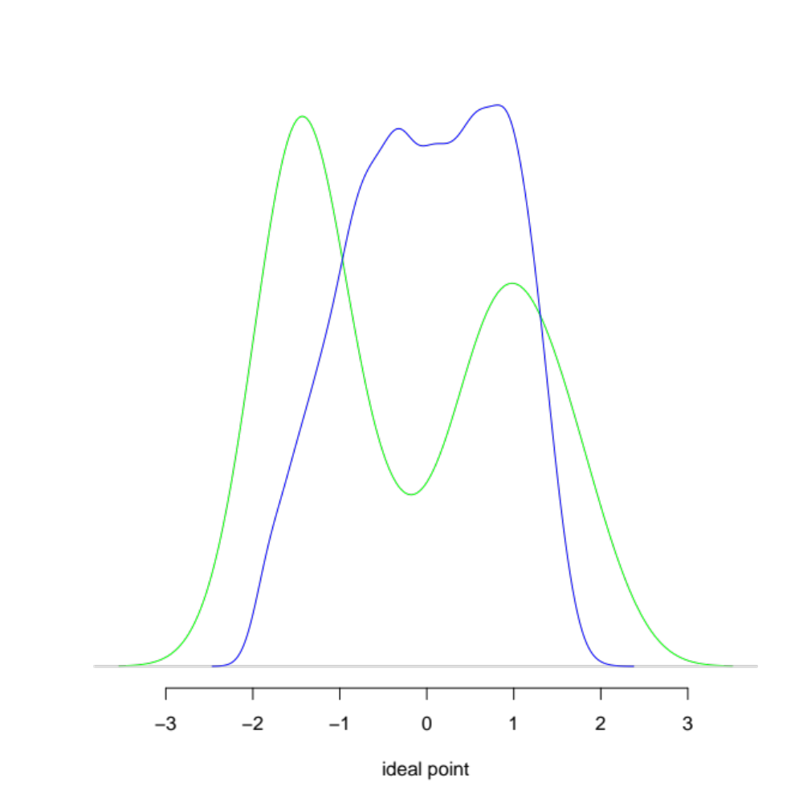
JESSEE ESTIMATES
Estimated distributions
Log likelihood reduced by 639 over not joint model

Slide 24
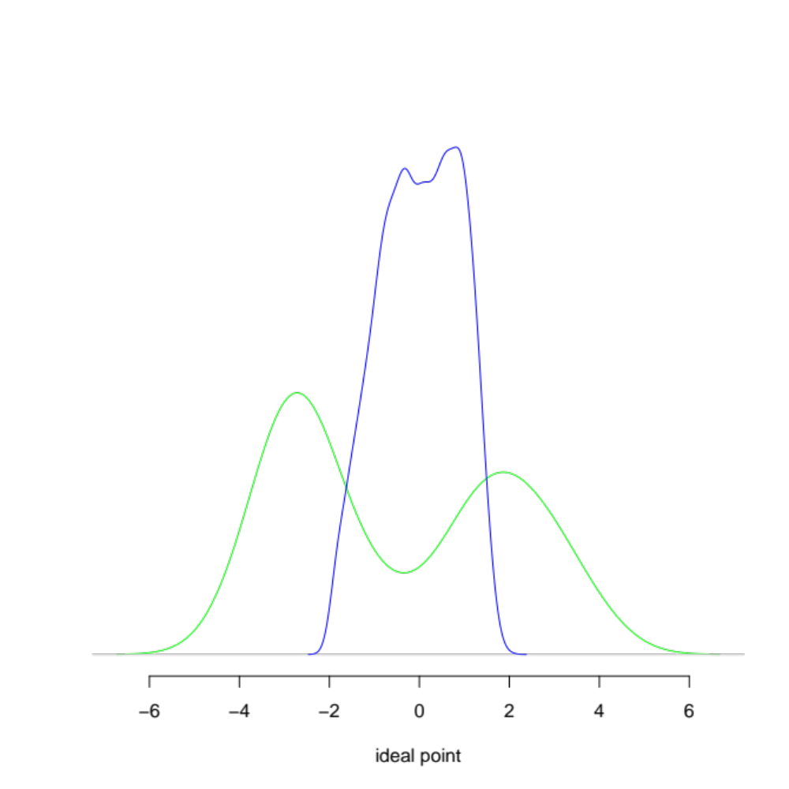
An equivalent “stretch”
Estimated distributions, with legislators stretched
Log likelihood reduced by less than 639 over joint model

Slide 25
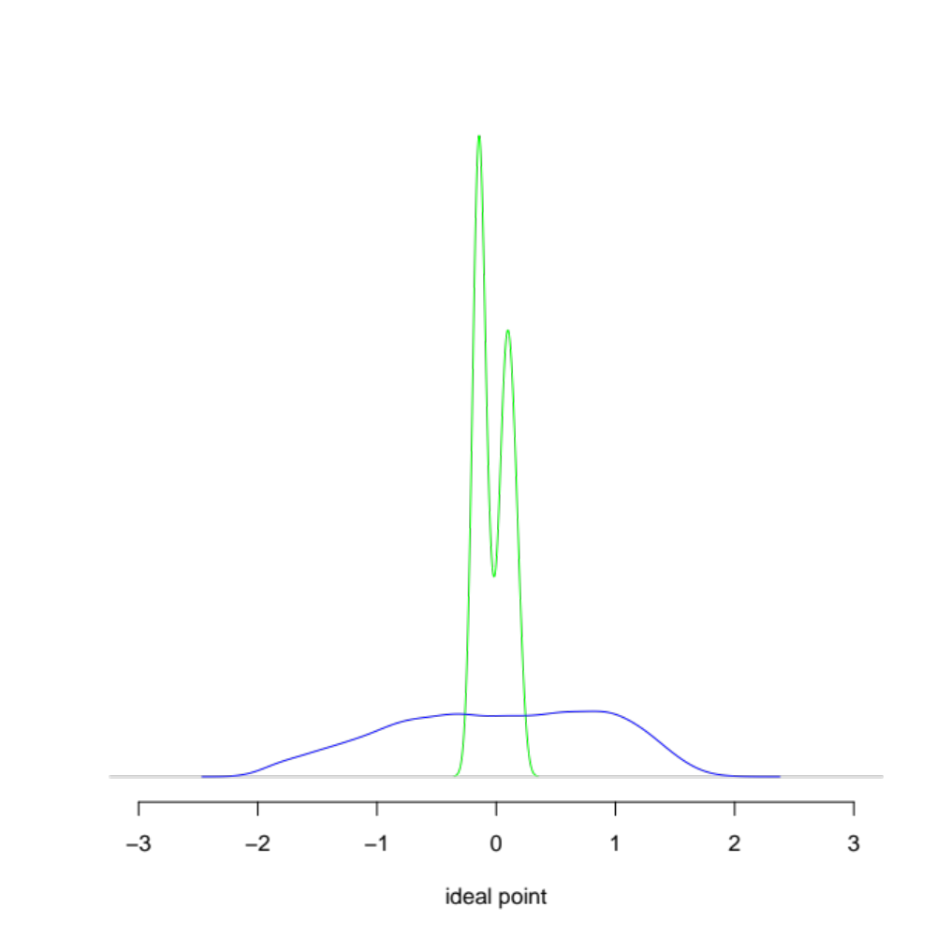
An equivalent “shrink”
Estimated distributions, with legislators dispersion reduced
Log likelihood reduced by less than 639 over joint model

Slide 26
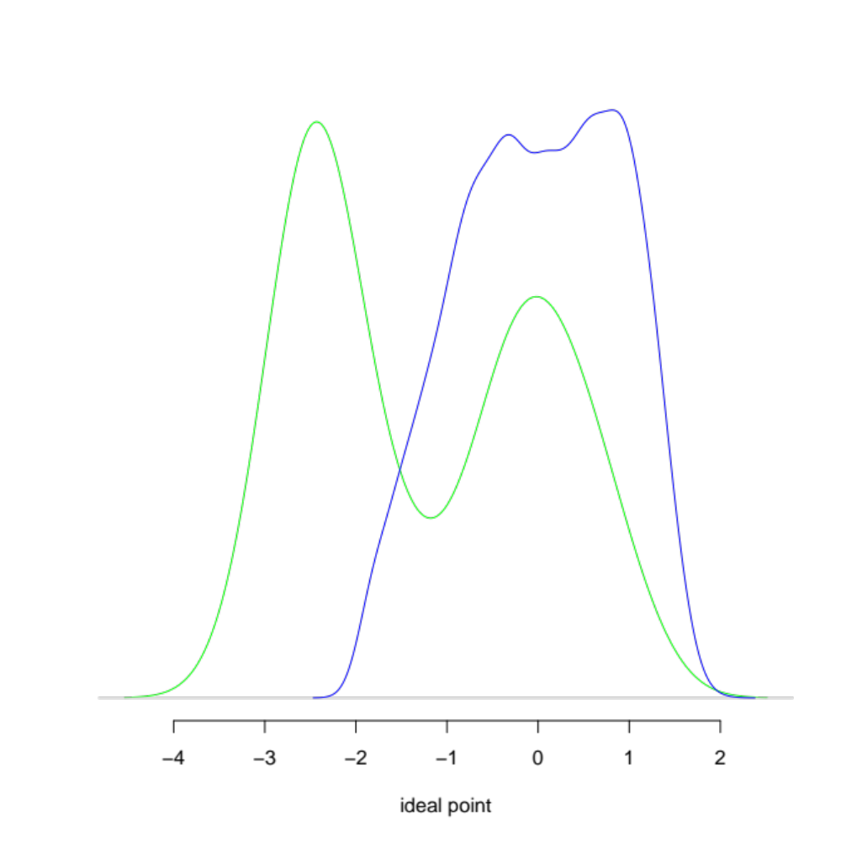
An equivalent shift left
Estimated distributions, legislators shifted left
Log likelihood reduced by less than 639 over joint model

Slide 27
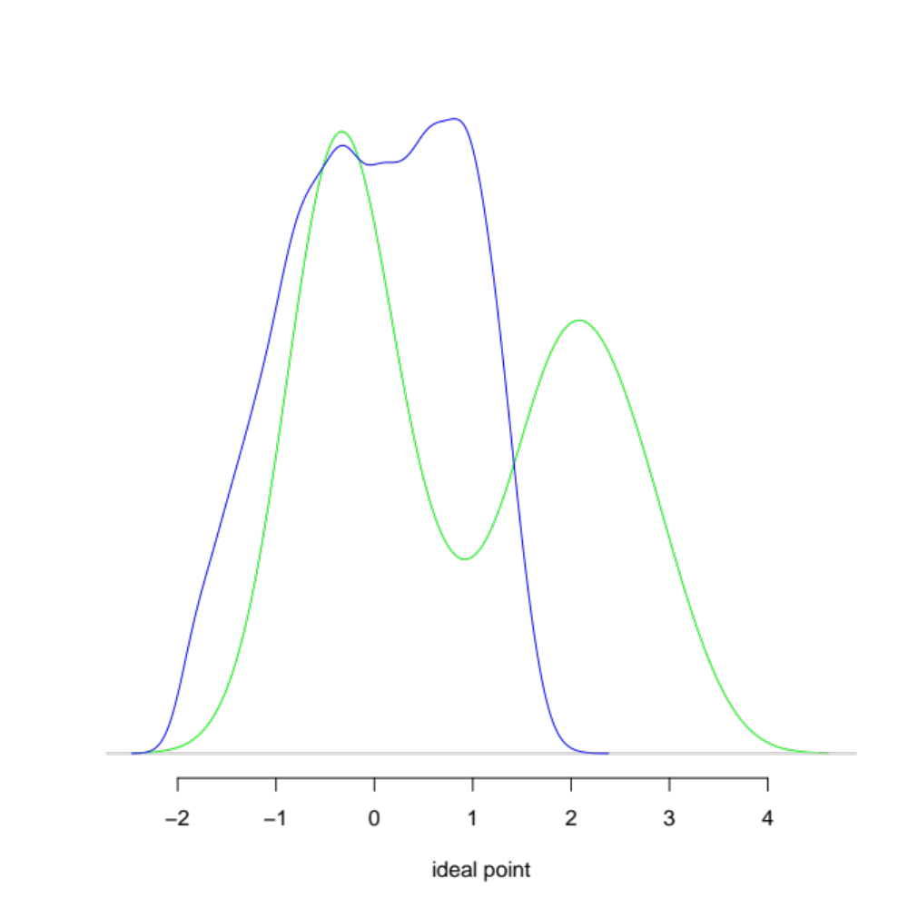
An equivalent shift right
Estimated distributions, legislators shifted right
Log likelihood reduced by less than 639 over joint model

Slide 28
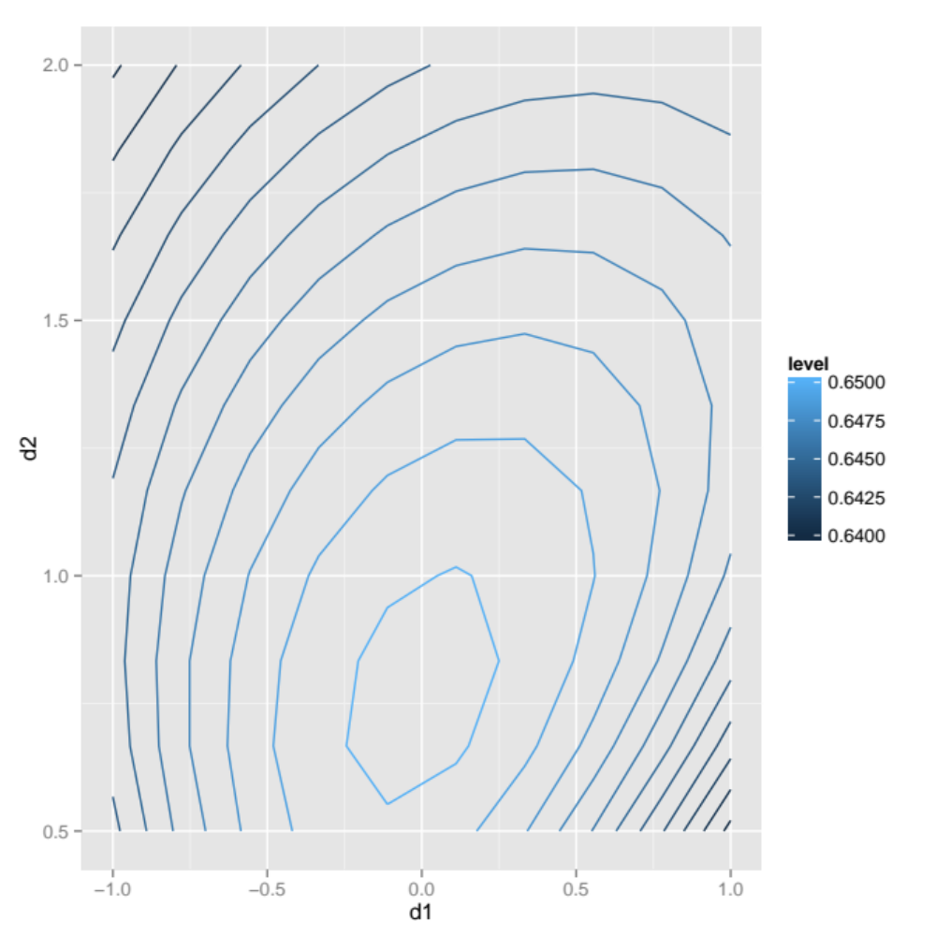
Likelihood contours
Notes:
Which ring of hell are we on?

Slide 29
conclusion
Proximity comparisons between legislators and constituents do not appear to be valid with current data
Remedies are not obvious. Possible directions:
  Different data
  Relaxed model assumptions
  Representation as a mapping between different spaces

Slide 30
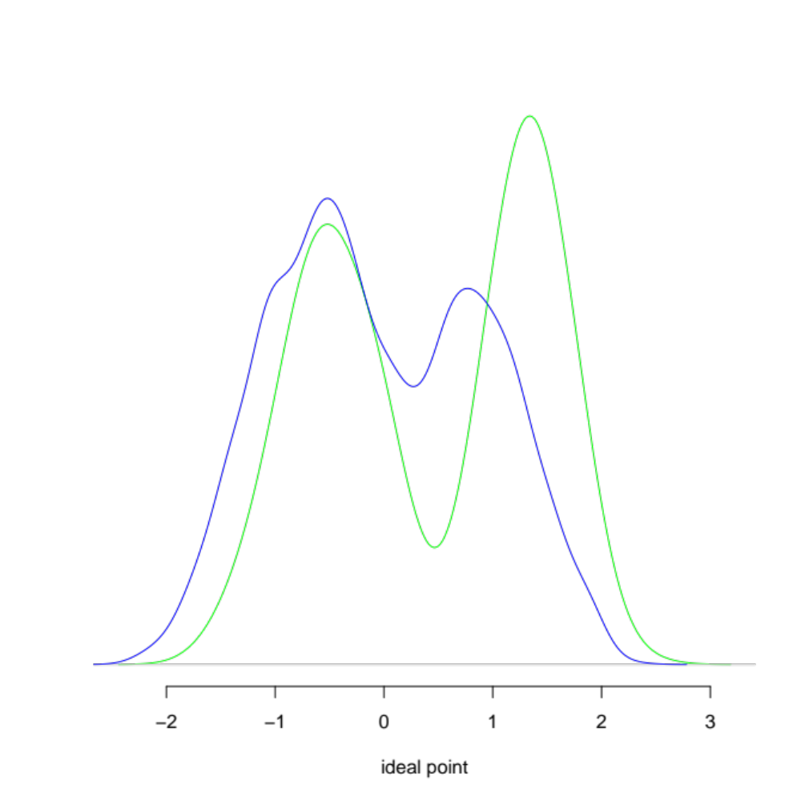
Bafumi and herron ESTIMATES
Estimated distributions
Log likelihood reduced by 1257 over not joint model

Slide 31
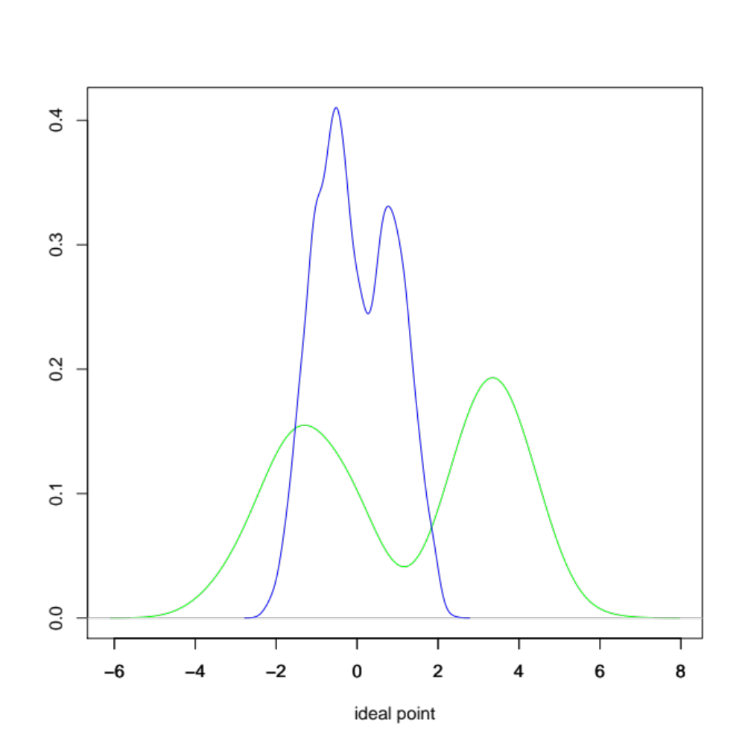
An equivalent “stretch”
Estimated distributions, with legislators stretched
Log likelihood reduced by less than 1257 over joint model

Slide 32
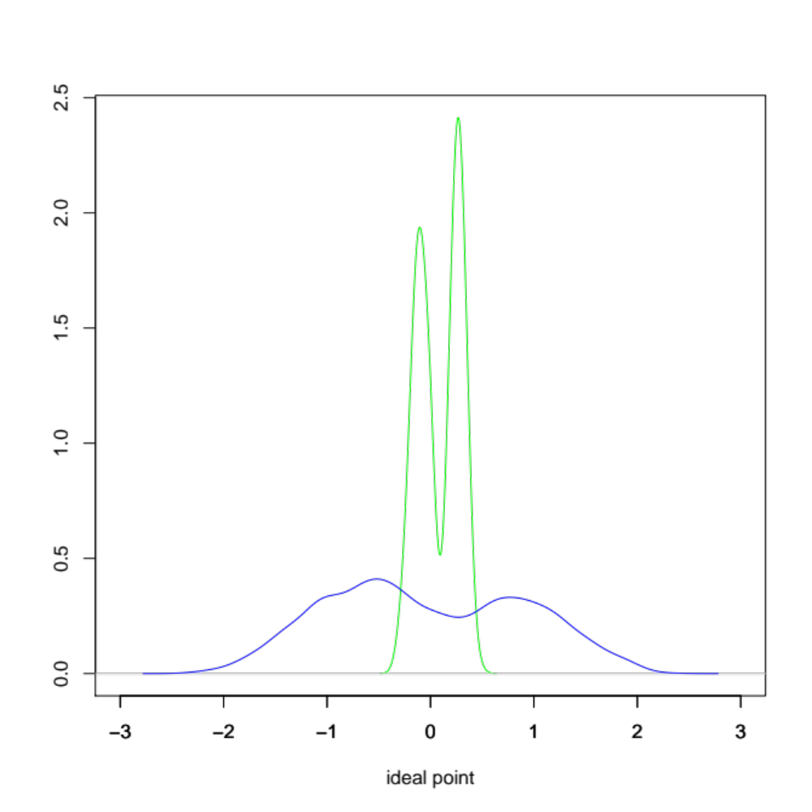
An equivalent “shrink”
Estimated distributions, with legislators dispersion reduced
Log likelihood reduced by less than 1257 over joint model

Slide 33
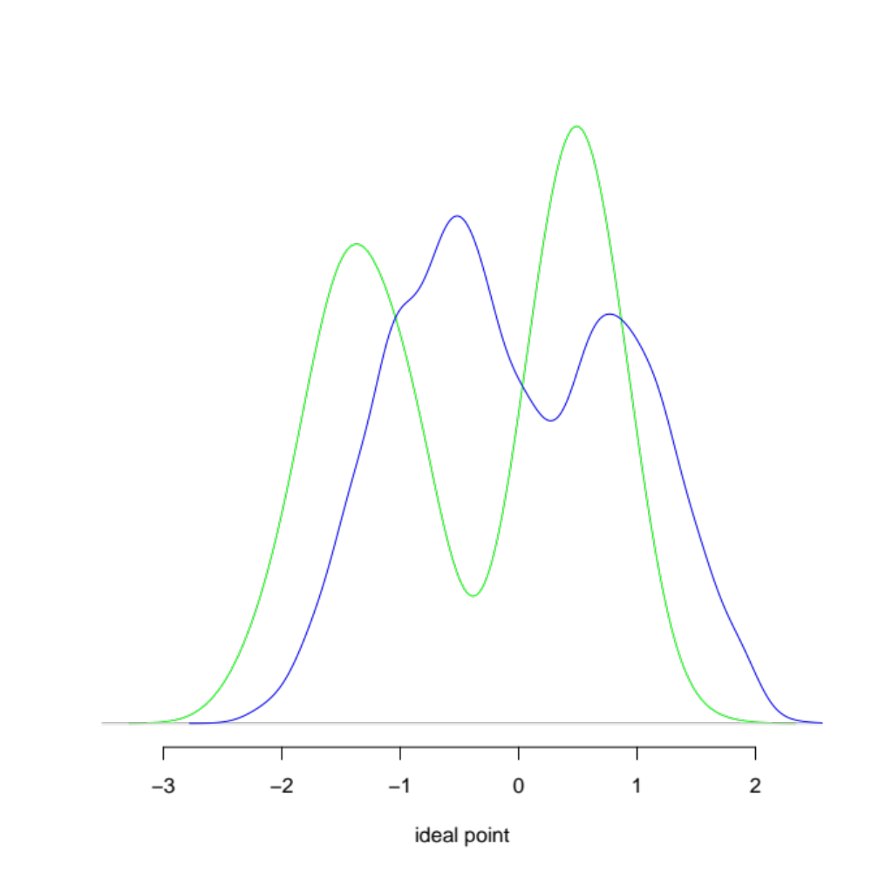
An equivalent shift left
Estimated distributions, legislators shifted left
Log likelihood reduced by less than 1257 over joint model

Slide 34
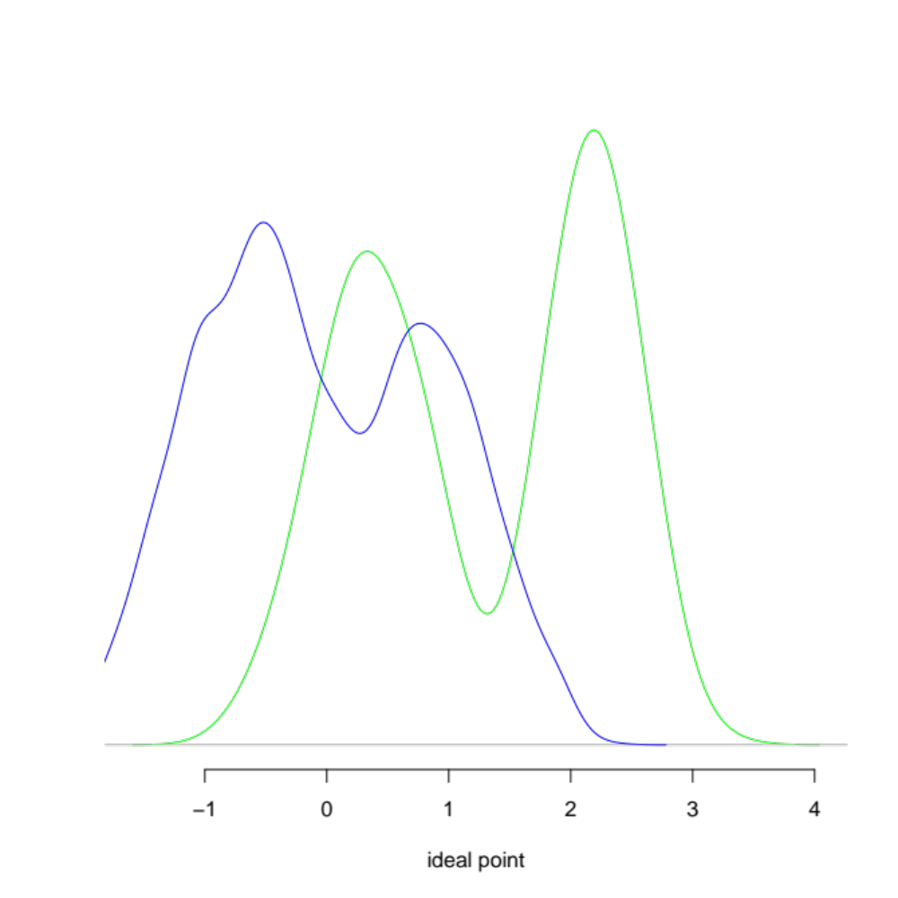
An equivalent shift right
Estimated distributions, legislators shifted right
Log likelihood reduced by less than 1257 over joint model

